Slide 1
Managing Anxiety and Stress and Eating Disorders
Fiona Duffy, Consultant Clinical Psychologist
University of Edinburgh
NHS Lothian CAMHS

Slide 2
What is anxiety and stress?
Stress is any demand placed on your brain or physical body. People can report feeling stressed when multiple competing demands are placed on them. The feeling of being stressed can be triggered by an event that makes you feel frustrated or nervous.
Anxiety is a feeling of fear, worry or unease. It can be a reaction to stress, or it can occur in people who are unable to identify significant stressors in their life.

Slide 3
Clinical Anxiety in Children
Anxiety is of the most common referral to CAMHS and thought to effect about 10% of young people
Inclusive of social phobia, generalised anxiety disorder, OCD, separation anxiety, phobias, PTSD

Slide 4
Clinical anxiety vs stress
Clinical anxiety is different to low level anxiety/stress:
Impact of difficulties on day to day functioning
Longer term e.g. not only in the context of transient stressor
Greater severity of symptoms e.g. more than would be typical/expected

Slide 5
Signs of anxiety
Psychological symptoms
Restlessness
A sense of dread
Feeling constantly “on edge”
Difficulty concentrating
Irritability
Negative thinking style e.g. catastrophising
Symptoms can cause you to withdraw from social contact to avoid feelings of worry and dread.

Slide 6
Physical symptoms
Dizziness
Tiredness
Heart palpitations
Muscle aches and tensions
Trembling or shaking
Dry mouth
Excessive sweating
Shortness of breath
Stomach ache
Feeling sick
Headaches
Difficulty falling asleep

Slide 7
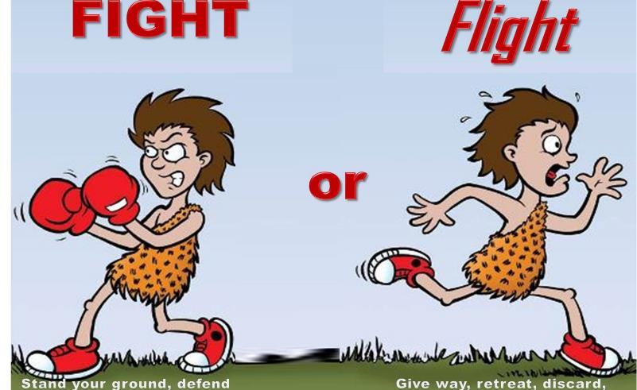
Fight or Flight

Slide 8

Important for motivation

Slide 9
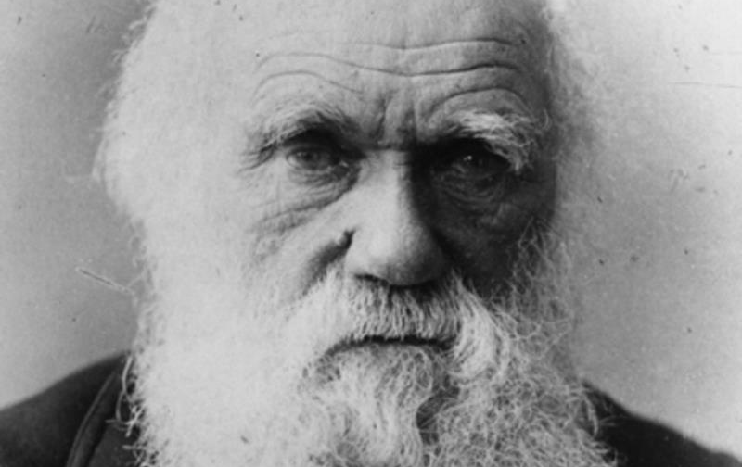
Survival of the Species!

Slide 10
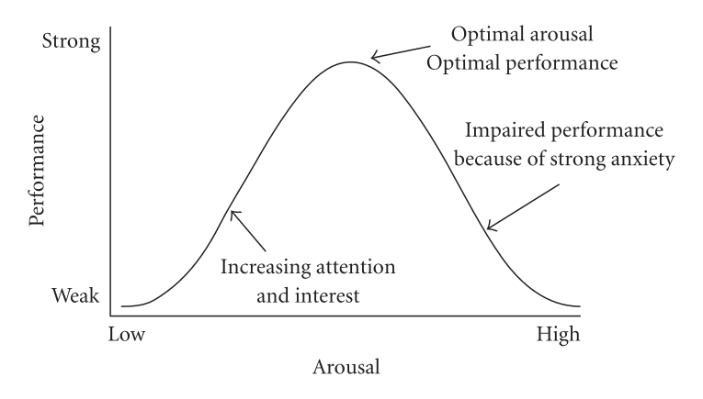
Performance

Slide 11
Managing Anxiety and Stress
Routine
Worry time – encouraging talking to others
Boundaries and rules
Managing avoidance
Supporting good sleep patterns
- Caffeine, screen time, environment, exercise, sleep routine
Encourage mistakes – especially with perfectionistic young people

Slide 12
Deep Breathing
Relaxation exercises – imagery, or muscular
General relaxing activities/hobbies
Distraction

Slide 13
Useful resources
Ayemind.com – pulls together approved mental health apps e.g. headspace
Moodjuice.scot.nhs.uk
Overcoming Anxiety – CBT based self help book

Slide 14
Eating disorders and body image

Slide 15
Typical Eating Disorders
Anorexia Nervosa
Bulimia Nervosa
Binge Eating Disorder
All have an underlying over evaluation of shape and weight
No one cause of eating disorders

Slide 16
Myths About Eating Disorders
Eating disorders are not serious, they are a lifestyle choice and all about vanity
Eating disorders are serious and potentially life threatening mental health disorder
A person with an eating disorder experiences severe disturbances in their behaviour around eating and exercise

Slide 17
Myth #2
Eating disorders are a “cry for attention” or someone going through a “phase”
Most people with an eating disorder go to great lengths to hide, disguise or deny their behaviour, or many don’t recognise that there is anything wrong.
People take an average of 7 years to recover from an eating disorder with many people taking years before they go for treatment.

Slide 18
Myth #3
You can tell by looking at someone that they have an eating disorder
The majority of people with an eating disorder (about 80%) are not underweight

Slide 19
Myth #4
Eating disorders only affect white middle class females, particularly adolescent girls
The peak period for the onset of eating disorders is 12-25 years, median age around 18 years. One high risk group is women, particularly those going through key transitions.
However – eating disorders can occur to anyone, across all cultures and socio-economic backgrounds, and all ages.
Studies suggest around a quarter of people with eating disorders are male.

Slide 20
Myth #5
Parents are to blame for eating disorders
“I have remarked that patients should be fed at regular intervals and surrounded by persons who would have moral control over them; relatives and friends being generally the worst attendants” Gull (1874)
There is no evidence that particular parenting styles cause eating disorders.
Instead family and friends play a crucial role in the care, support and recovery of people with eating disorders

Slide 21
Early Warning Signs
Strict dieting and avoiding specific foods/food groups
Avoiding eating with others
Drinking a lot of water or fizzy drinks
Frequent weighing and or excessive exercising
Increasing isolation and loss of friends
Preoccupation with food, weight and shape
Distorted perception of shape and weight
Underestimating or denying the problem
Feeling distressed or guilty after eating
Fear of gaining weight
Irritability, excessive perfectionism, low self-esteem

Slide 22
Physical Signs
Weight loss
Irregular periods
Difficulty sleeping and tiredness
Feeling dizzy
Constipation and Bloating
Feeling cold
Growth of soft, fine hair all over your body
Hair loss
Physical weakness
Damage to teeth
Enlarged salivary glands

Slide 23
Difficulties with Early Identification and Intervention
Tend to be secretive and are associated with guilt and embarrassment.
Young people with ED’s don’t usually view themselves as ill, so don’t seek help
People often find it difficult to discuss their concerns with them
If concerns are expressed, the young person often denies the problem
Although Anorexia is more visible due to weight loss, most young people with ED’s are not underweight and go unnoticed.
Peers might be aware of a problem, but feel they cannot approach an adult to expose their friend.

Slide 24
I’ve got concerns – what do I do next?
Talk to the young person!
Assessment of their eating difficulties, medical reasons for any weight loss from their GP including a baseline measurement of weight, height and other physical measures
Referral to CAMHS.
Useful resources:
BEAT’s website
caredscotland.co.uk
Eva Musby website and books

Slide 25
Our work with Royal High
Focused on prevention of eating disorders by targeting body image difficulties in teenagers
Body Image: how we think and feel about our bodies.
Body Image dissatisfaction is common in adolescent but higher rates are a risk factor for increased risk of mental health difficulties and unhealthy behaviors in later life

Slide 26
Body Image Group
Run three groups over the last 3 years for young people (S1’s and S2’s who feel they have negative body image).
Focuses on the links with body image difficulties and relationships
Includes education and skills to mange:
Weight and shape talk in peer groups or families
Fat talk
General relationship difficulties

Slide 27
Fat Talk
Negative body related conversations between friends about your own body
Linked with body shame, body dissatisfaction and eating disordered behaviors
What's wrong with this?
Engages others in fat talk
Facilitates comparisons
Continues to support a culture where body shape and weight are of heightened importance in day to day life

Slide 28

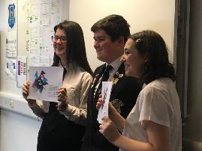
National Lottery Project
Develop some body image workshops for all classes that can be used in High school and P7’s
S6 pupils are used as group facilitators
Focus on body image and social media, thinking about skills on how to navigate it
Launched in September

