Slide 1

S2 into S3
Course Choice Information Evening
08/01/2026
Tonight's presentation will be uploaded to:
Course Choice – The Royal High School
The S1-S3 Option Choices Skills Development Scotland webinar is available here:
Option Choices webinar for parents and carers of S1 to S3 pupils

Slide 2
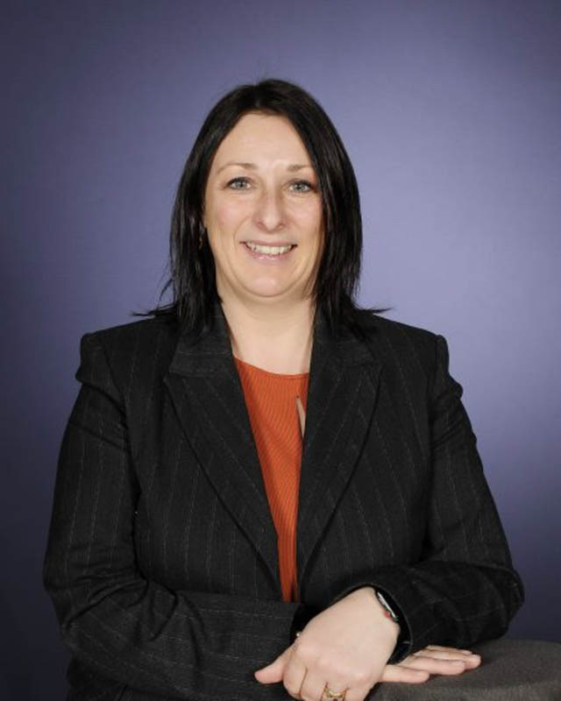
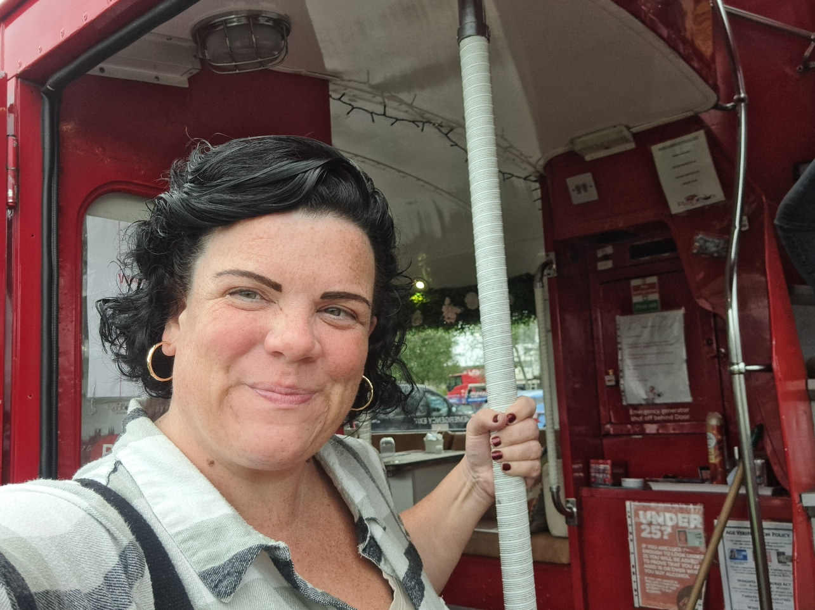
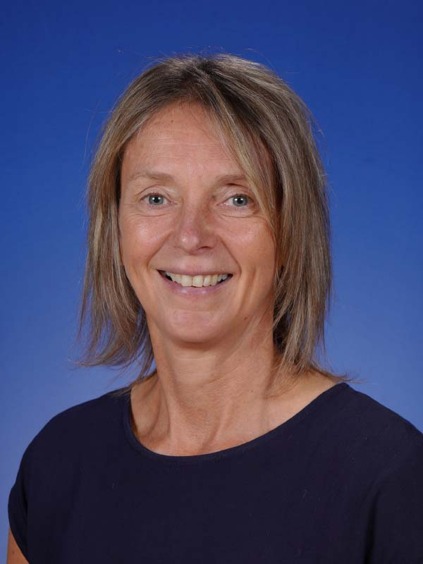
Pauline Walker - Head Teacher
Louise Winser – Careers Adviser
Jen Menzies - DHT
Outline
Skills Development Scotland
The Big Picture: Pathways and Qualifications
Progression from the Broad General Education (S1-S3) to the Senior Phase (S4-S6)
Your child’s report (Monday 6 January)
Maximising Parents Evening (Wednesday 15 January)
Course Choice Process (Mon 19 and Tues 20 January)
Questions

Slide 3

Louise Winser
Careers Adviser
5 Days per week
Block 2 – Block 7
Library - Careers Pod
Notes:
Work Skills Development Scotland ( SCOTLAND NATIONAL CAREERS AGENCY) but based in RHS most days

Slide 4
How we help your young person in school
SDS are in schools to help young people understand the world of work.
To help them develop and use their career management skills as they move throughout school.
We do this through our online service, My World of Work, and in person through our careers advisers.
Young people may meet their school careers adviser…
In class at a group session At drop-in sessions At one-to-one appointments
Notes:
So how do we help your young person in school?
We start introducing careers to young people early in their school journey – to support young people to feel confident in making informed choices at later stages of school or at critical points such as option choice here in S2.
We never tell young people what to do but will work with them to help them discover what's right for them, help them questions things , sign-post to research options and up to date careers information.
SDS advisers see pupils in group sessions, one-to-one appointments, or at drop-in times.
We start this in S1 and continue throughout the school years , for careers interventions for each year group through 1:1’s, Assemblies and group sessions in the PSE class where we will use tools, resources and interative activities. Taking a steer from RHS and what they would like to prioritize and have included in their careers education input

Slide 5
Support and conversations we may have in school
SDS careers advisers might speak to your young person about:
Finding out about their self, strengths and skills
Routes into careers including apprenticeships
Making decisions such as option choices
Building and developing networks
Different types of careers and how to research them
Help with creating CVs
Developing the types of skills that are useful in a job
Making applications and applying for courses
Notes:
The types of conversations that may happen during the whole class sessions, at one-to-one appointments, or at the drop-in sessions include...
S2 OPTION CHOICE – Careers 1:1’s started in MID OCT. With us trying to see the full year group by this time of the year. Offering mop up session as best we can slot in.
This unique support is available to all young people in school, with more tailored support offered as best we can, to young people with additional supports needs. Recently adapting the format for a none verbal pupil.

Slide 6

Career Management
Skills
Notes:
Along with Academic study towards Nationals, Highers, NPA’s, we work to identify META SKILLS and the links to careers Industry
THIS INCLUDES CAREER MGT SKILLS.
Recap on CMS:
Career Management Skills are skills for life empowering us to strengthen our understanding of the four themes: Self, Strengths, Horizons and Networks. They help us to make informed decisions and realise our potential at any point. If you feel confident that you have a good understanding of these four themes and can demonstrate this, then you will be well equipped to cope with developing your career AND MAKING EFFETIVE DECSIONS.
The four areas are:
SELF is about
Understanding who you are and what you like
STRENGTHS is about
Understanding what you are good at
HORIZONS is about
Understanding what options might be available to you
NETWORKS is about
Understanding who can help you, and how.
At this stage (preparing for option choices this year) we will be concentrating on Self and Strengths so ensuring they are best prepared for this decision making process.

Slide 7
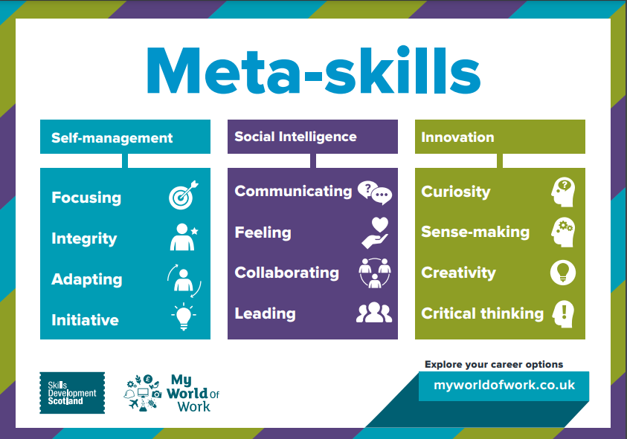
Notes:
Discussions around the skills, qualities and attributes needed for particular careers, routes and pathways and how these can be achieved through certain subjects, courses and academies.

Slide 8





Skills Shortages - Technical Skills Employers Want
SPECIALIST SKILLS & KNOWLEDGE
OPERATIONAL SKILLS
COMPLEX ANALYTICAL SKILLS
DIGITAL SKILLS
BASIC
SKILLS
31% of
SCOTTISH EMPLOYERS couldn’t fill a vacancy because applicants didn’t have key skills
Knowledge of products & services
.
Creative & innovative thinking
Solving
complex problems
.
Complex numerical or statistics skills
Why can’t I find anyone with the Technical Skills we need!
Basic numeracy
Basic IT skills
Basic IT skills
Advanced / specialist IT skills
SOURCE: Employers Skills Survey 2022 – Scotland Report, published 29 November 2023
Notes:
WE USE OUR DATA AND LARGE AMOUNT OF LMI to being information back to our pupils in digestible ways and to help them make informed choices
A quarter of Scottish employers surveyed (5,207 Scottish establishments) had at least 1 vacancy in 2022. Almost a third of Scottish Employers (31%) with a job opening reported applicants lacked the skills package they were looking for.
Specialist skills & Knowledge was the essential skill employers were most likely to highlight as missing among applicants (in 57% of Skills Shortage Vacancies). Next was Operational Skills (47%), Complex Analytical Skills (46%), Basic Skills (40%) and Digital Skills (33%). Both Digital and Basic Skills included Basic IT such as turning on computers, changing a password and basic Microsoft Office skills. More than 1 in 10 digital Skills Shortage Vacancy (SSV) was caused by lack of basic internet skills, including not being able to communicate via email.
Skills Shortage Vacancy (SSV) – when a job opening has enough applicants, but those applying do not have the skills, qualifications or experience the employer believes is essential for the job.
TECHNICAL SKILLS – specific technical and practical skills required to perform particular functions in a job role.
SOURCE: UK Employer Skills Survey 2022 – Scotland Report, published 29 November 2023 - https://www.gov.scot/publications/uk-employer-skills-survey-2022-scotland-report/documents/
IMAGE: from SDS MyWoW industry pages 2023-24

Slide 9





Where did last year's school leavers go? Initial Destinations
40.8% Higher Education
26.4% Further Education
23.1% Employment
5.4% Training*
4.0% Unemployment
Initial School Leaver Destinations in Scotland
3 Months after leaving school in 2024
Title
95.7%
In a positive destinations
SOURCE: Scottish Government Summary Statistics for Attainment & Initial Leaver Destinations, No. 7: 2025 Edition, February 2025
*Training, voluntary work & Personal Skills Development data has been combined
Notes:
WE USE OUR DATA AND LARGE AMOUNT OF LMI to being information back to our pupils in digestible ways and to help them make informed choices
We will get 2025 data in a few months = March 2026 to help tailor our careers support.
SCOTTISH FIGURES 2023-24. For other Local/School information or years see SOURCE.
55,988 pupils left school in 2024 (+1,245 more leavers than in 2023). 95.7% entered positive destinations (down from 95.9%).
Just over 67% of leavers went into Further (FE) or Higher education (HE).
Higher Education: 40.8% - increased from 40.3% in 2022-23
Further Education: 26.4% - decrease from 26.6% in 2022-23
Employment: 23.1% - decreased from 24.3%in 2022-23
Unemployed: 4.0% - increased from 3.8% in 2022-23
NOTE: *Training (3.9%) incorporates voluntary work (0.6%) and Personal Skills Development (0.9%) figures.
NOTE: Unemployment includes Unemployed Seeking (2.2%), Unemployed Not Seeking (1. 9%) and Unknown (0.3%).
SOURCE: Scottish Government Summary Statistics for Attainment & Initial Leaver Destinations, No. 7: 2025 Edition, published 25 February 2025 https://www.gov.scot/publications/summary-statistics-for-attainment-and-initial-leaver-destinations-no-7-2025-edition/pages/section-3-school-leaver-initial-destinations/
Also see RSA Data Matrix ‘Skills Supply’ for positive and negative destination figures by local authority
NEXT UPDATE: March 2026

Slide 10

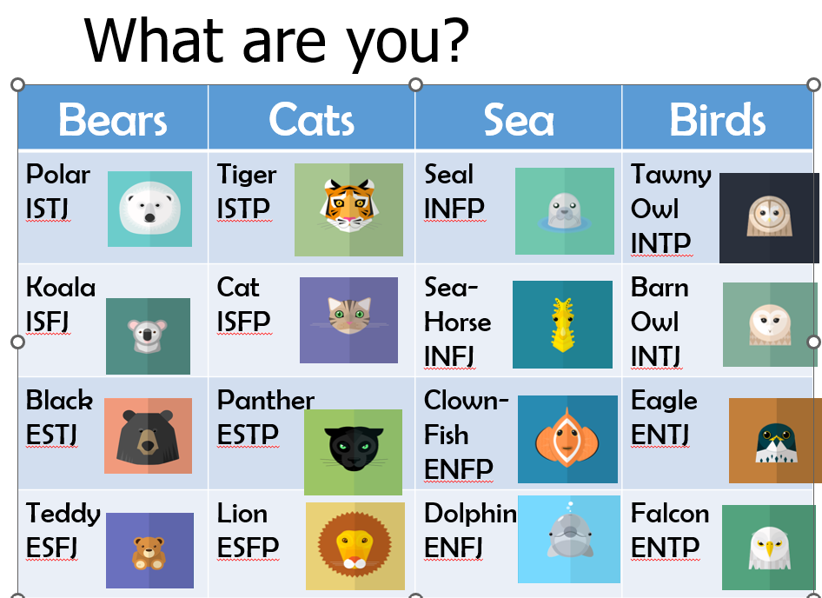
Notes:
EACH S2 PUPIL HAS BEEN INVITED TO ATTEND A SHORT CAREERS APPOINTMENT AND PROVIDED THE FLYER NOTED HERE.
Guidance have also been using careers resources such as animal me in PSE classes.

Slide 11
If your S2 pupil has missed out on their appointment, please ask them to pop into the library at either break or lunchtime this week and next and they will be made a priority appointment.
As best we can, we have offered mop up appointments and extra dates to accommodate illness and other absences.
Notes:
EACH S2 PUPIL HAS BEEN INVITED TO ATTEND A SHORT CAREERS APPOINTMENT AND PROVIDED THE FLYER NOTED HERE.
Guidance have also been using careers resources such as animal me in PSE classes.

Slide 12
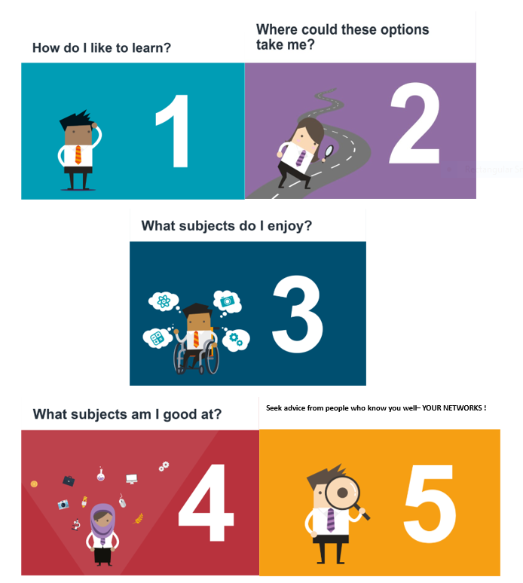

Notes:
How do I like to learn? S2 - ASSSEMBLY ON FRIDAY TO REVISIT SOME OF THIS.
Do you enjoy English and Modern Languages as you get to talk and listen? Do you prefer Art and Design as you like ot be creative or Science subjects as you like to asylise information and dopractical experiments.
Think about how you like to learn.
Where could these subjects take me?
Certain college and university courses, and some Modern or Graduate Apprenticeships require you to have studied certain subjects at school to gain entry. Think about the types of jobs that might suit you.
What subjects do I enjoy?
if you are interested in a subject, learning about it and studying it can be quite fun! If you're doing something you love, you're more likely to do well.
What subjects am I good at?
Consider the subjects you've done well in before. But remember, subject choice time is an opportunity to study subjects you've never done before.
Consider all of your options carefully.
What do other people think?
This is not about doing what your pals are doing but about asking people what they think you are good at and could do well in.
Remember, the final choice is yours.

Slide 13
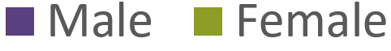
Schools Leaver Qualifications – Gender Bias
Of those sitting Highers in 2023, 54% were female and 46% male
Most subjects had reasonable gender balance, including:
English – 56% female and 44% male
& Maths – 54% male and 46% female
Some subjects were still dominated by one gender:
SOURCE: SQA Attainment Statistics 2023, published December 2023
Notes:
SCOTTISH FIGURES - SQA
In 2023, 191,820 pupils sat at least 1 Higher.
Out of over 50 higher subjects taken 27 had a reasonable gender balance (within the 65% to 35% range).
English and Maths had good gender balance, although almost twice as many pupils sat an English Higher (35,505 pupils) than a math higher (18,705 pupils).
NOT ON SCREEN: other subjects where at least 70% of the Higher group is female include: Psychology & Gaelic (Learners) (both 75%); Religious, Moral & Philosophical Studies & French (both 73%); Gaidhlig (72%) Sociology, Spanish & Drama (all 71%).
SOURCE: SQA Attainment Statistics 2023: https://www.sqa.org.uk/sqa/105123.html published December 2023.
SEE CIAG School Resources – data on the slide is an extract from ‘Subject Choice Facts’ - see Broad General Education, Preparing to Make Choices, Menu of Activities – Subject Choice & Unconscious Bias for the Subject Choice Facts 2024

Slide 14

Notes:
Talk through Option choice tool and how this can be used. QR code will direct them here.

Slide 15

Notes:
SUBJECT NEEDED & USEFUL TO HAVE
META SKILLS NEEDED
ABOUT THE JOB – understand what the job will involve and the pros and cons.

Slide 16
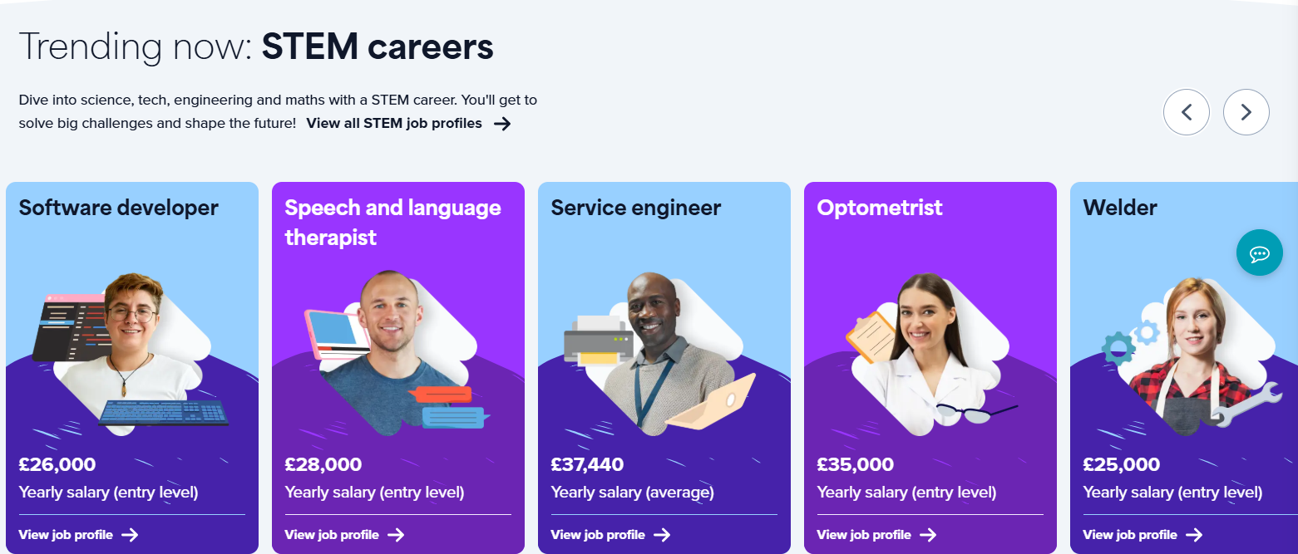

Slide 17
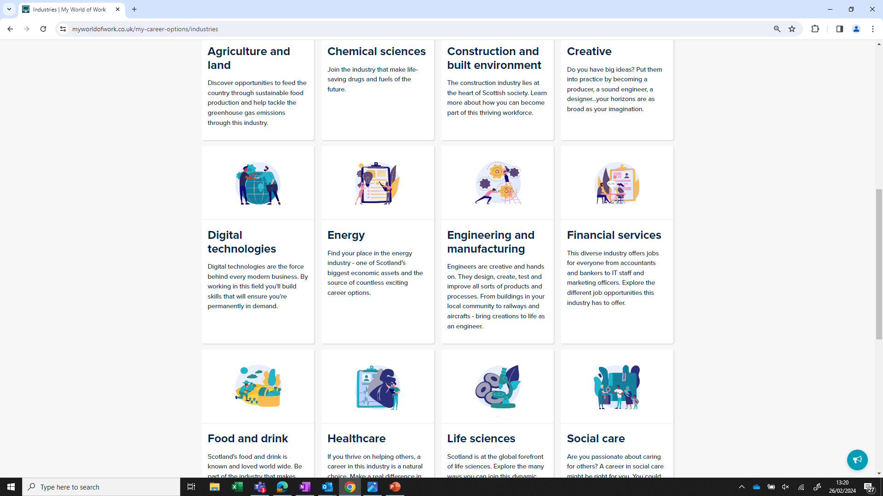
My world of Work
⬇
Explore Careers
⬇
Industries Section
For career inspiration & Subjects needed for the industry or sector

Slide 18


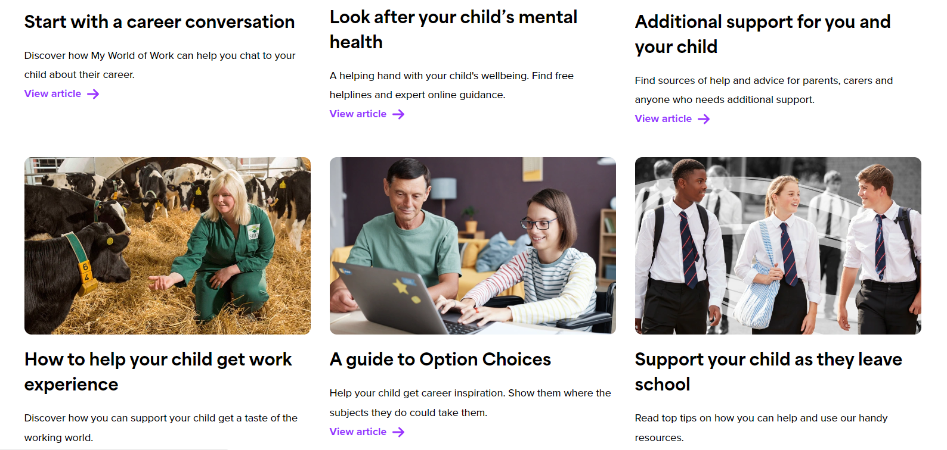

Slide 19
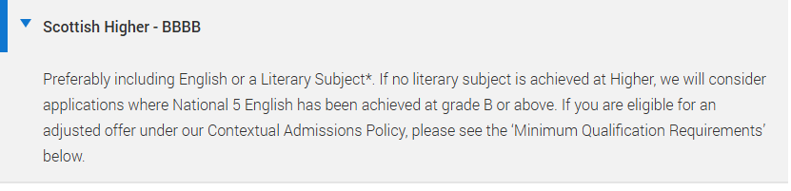
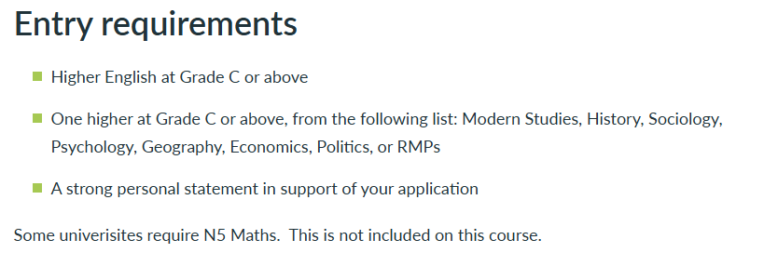
Search - UCAS
The Big Picture: Pathways and Qualifications
Edinburgh Napier – Degree in Criminology
Full-time courses | Edinburgh College
Edinburgh College – HNC in Social Science

Slide 20
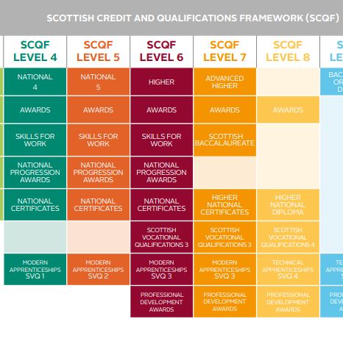

The Big Picture: Pathways and Qualifications
nutshells_pathway_E.pdf
Our Curriculum Pathways – The Royal High School

Slide 21


Progression from the Broad General Education (S1-S3) to the Senior Phase (S4-S6)
S3
English (4)
Maths (4)
Choice 1 (3)
Choice 2 (3)
Choice 3 (3)
Choice 4 (3)
Choice 5 (3)
Choice 6 (3)
Academies (2)
Physical Education (2)
Social Education (1)
Religious Education (1)
S4
Choice 1 (4)
Choice 2 (4)
Choice 3 (4)
Choice 4 (4)
Choice 5 (4)
English (4)
Maths (4)
Physical Education (2)
Social Education (1)
Religious Education (1)
S5
Choice 1 (4/6)
Choice 2 (4/6)
Choice 3 (4/6)
Choice 4 (4/6)
Choice 5 (4/6)
Academy (1)
Social Education/Study (1)
S6
Choice 1 (4/6)
Choice 2 (4/6)
Choice 3 (4/6)
Choice 4 (4/6)
Academy (1)
Social Education/Study (1)

Slide 22
In S3, your child will study 8 subjects in total.
These subjects will form the basis for their National Qualifications in S4, where they will continue with 7 of them at National level.
Subjects offered
English and Mathematics are compulsory and will continue automatically.
Your child will then choose 6 other subjects to study in S3.
We strongly recommend that your child's 6 choices come from a wide range of curricular areas.
This helps keep their future options open and supports a smooth transition into S4 and then onto future pathways.

Slide 23
S3 Broad General Education – 6 Free Choice
Course Choice – The Royal High School

Slide 24
S3 Broad General Education – Academies
Academies Option: Skills and Future Pathways
Your child also needs to choose an Academies option. This will help develop knowledge and skills in subjects that will become available as they progress into National Qualifications.
In the boxes provided, your child will list 3 chosen subjects in rank order (1–3) — with 1 being their top choice. They will be allocated 1 of the 3 chosen.
Not all subjects will run as it will be dependent on numbers and staff being available on their Timetable.
Subject | Rank | Subject | Rank | Subject | Rank
Aquademy Development and Leading |  | Experimenting in Art |  | Netball Leadership and Umpiring
Criminology |  | Film and Screen |  | People and Society
Cycle Maintenance |  | Football Development and Coaching |  | Rugby Development and Coaching
Dance Leaders |  | Jewellery Making |  | Scottish Studies
Duke of Edinburgh Bronze |  | Junk Kouture |  | Social Anthropology
Enterprise & 3D Print Club |  | Latin |  | Young Stem Leader
ESOL |  | Multi-Sport Development and Coaching
Event Organisation |  | Musical Theatre

Slide 25
Senior Phase S4 – Almost all will continue with 7 of the 8 subjects selected in S3.
Opportunity to achieve 7 SQA National Qualifications by the end of S4.

Slide 26
Alternative pathways from S3 into the Senior Phase
Subject Name
Applications of Mathematics (NAT5)
Barbering NPA (45)
Computer Games Development (45)
Criminology NPA (45)
Fashion & Textile: (NAT5)
Hospitality Barista Skills (45)
Make-up and Eye Treatments NPA (45)
Photography (45)
Sport Fitness (45)
Travel & Tourism (NAT5)

Slide 27
Senior Phase S5 – opportunity to achieve 5 SQA National Qualifications.
Senior Phase S6 – opportunity to achieve 4 SQA National Qualifications.

Slide 28
What this might look like - by the end of S6
S4
S5
S6
2023
2024
2025
Course Name
Results
Course Name
Results
Course Name
Results
Mathematics
N4:P
Applications of Mathemati
N5:C
Applications of Mathematic
HI:C
English
N5:B
English
HI:D
English
HI:B
Biology
N4:P
Biology
N5:C
Biology
HI:C
Physical Education
N5:A
Physical Education
HI:B
Physical Education
AHI:4
History
N5:C
Modern Studies
N5:C
Practical Cookery
N5:A
Business Management
N5:D
Business Management
HI:C

Slide 29
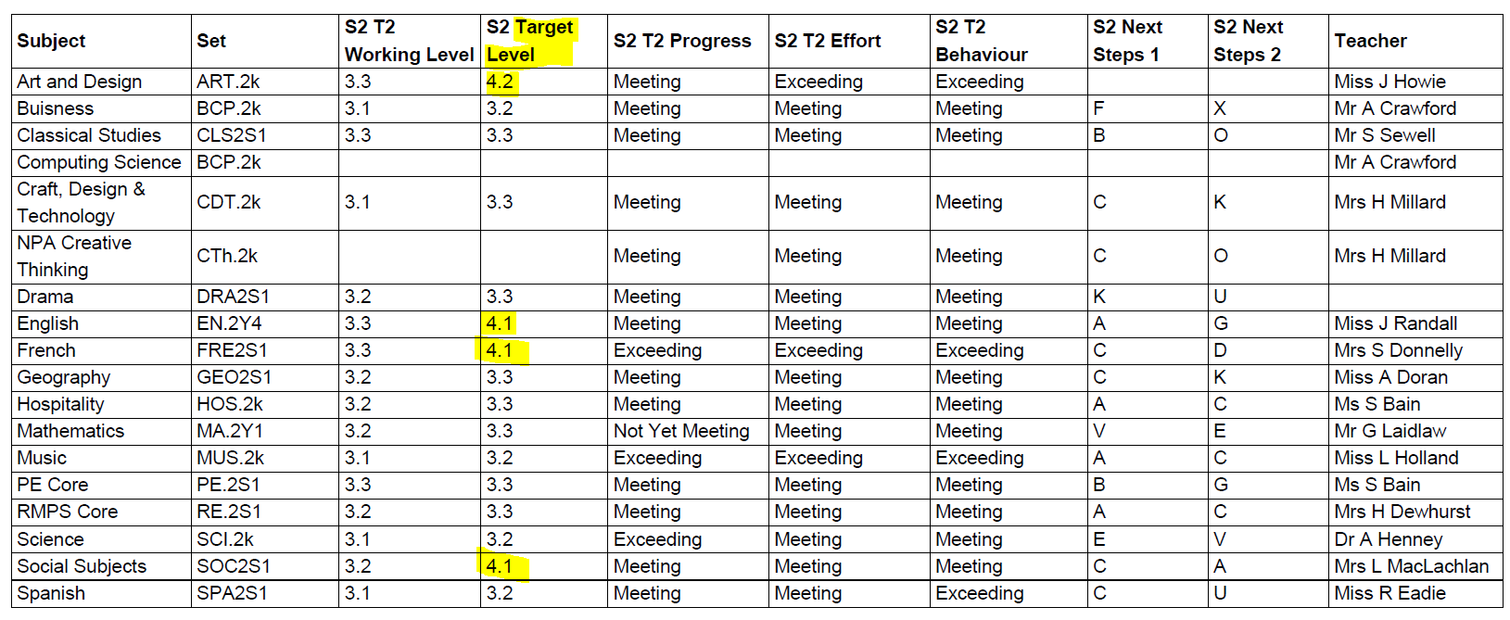
Your child’s report

Slide 30

Pathway Planning: Understanding Levels
S2 | Typically, Working Level 3.1, 3.2, 3.3, 4.1
S3 | Typically, Working Level 4.1, 4.2, 4.3, 5.1
End of S3 | Working at Level 4/5 will likely be coursed into Level 5 (National 5) SQA subjects.
End of S3 | Working at Level 3 will likely be coursed into Level 4 (National 4) SQA subjects.
End of S4 | On track to achieve Level 4/National 4 Level 5/National 5 On track to achieve Level 5/National 5 Level 6/Higher

Slide 31
Maximising Parents Evening
What further information would help you support your child’s choices?
Further clarification on child’s learning.
The way the subject is assessed in the Senior Phase.
The subject pathways.
https://royalhighschool.co.uk/faculty-pathways

Slide 32
Course Choice Process (20/21 January)

Slide 33
Pupil 1
No Science
Pupil 2
5 Technologies
Pupil 3
3 Science
Pupil 4

Slide 34
E-mail Confirmation of Course Choice
This is an Email Confirmation from The Royal High School
To: the Parent or Carer of Jen Menzies
Dear Parent or Carer,
This is to confirm that you have requested the following choices:
1=Spanish
2=Biology
3=Classical Studies
4=Physical Education
5=Graphic Communications
6=Modern Studies
R=Music
S2 Course Choice with Guidance
19/01/2026 and 20/01/2026

Slide 35
Subject uptake- next steps
Subject Name
Projected Number New S3 (sets)
Art (CfE)
73 (4)
Biology (CfE)
137 (7)
Business Management (CfE)
78 (3)
Chemistry (CfE)
112 (6)
Classical Studies (CfE)
25 (1)
Computing (CfE)
41 (3)
Computing Science Games & Digital Media (CfE)
25 (2)
Creative Thinking Skills (CfE)
15 (1)
Dance (CfE)
20 (1)
Drama (CfE)
52 (2)
Electronics (CfE)
23 (2)
Fashion & Textile (CfE)
28 (2)
French (CfE)
70 (3)
Geography (CfE)
52 (2)
Graphic Communication (CfE)
21 (2)
History (CfE)
101 (4)
Hospitality (CfE)
103 (6)
Media Studies (CfE)
26 (1)
Modern Studies (CfE)
90 (3)
Music (CfE)
54 (2)
Music Tech(CfE)
6 (1)
Physical Education (CfE)
107 (4)
Physics (CfE)
85 (5)
Practical Craft Skills (CfE)
53 (3)
Religious, Moral & Philosophical Ed (CfE)
29 (1)
Spanish (CfE)
70 (3)

Slide 36
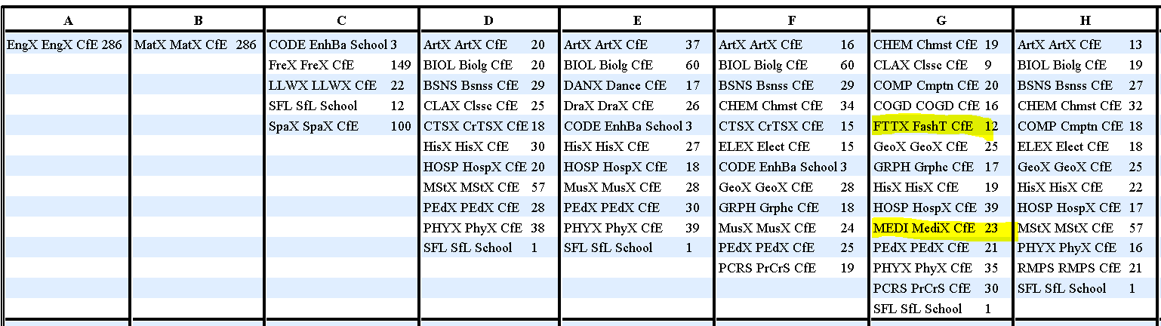
Subject uptake- next steps- continued
Unlikely to happen but issues to be aware of:
A course may not run if not enough pupils choose it.
Your child may have a unique combination of subjects that don’t work when their choices are moved into columns for Timetabling.

Slide 37
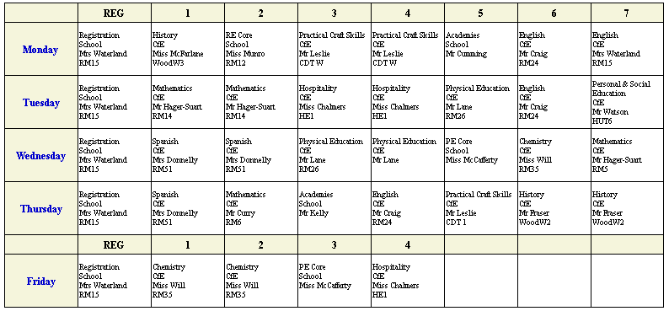
New timetables starts Tuesday 20 May

Slide 38
Depute Headteachers
Angles & Picts: Jennifer Menzies Jennifer.Menzies@royalhigh.edin.sch.uk
Brits & Gaels: Nicola Casey Nicola.Casey@royalhigh.edin.sch.uk
Celts & Scots: Maxine Hughes Maxine.Hughes@royalhigh.edin.sch.uk
Pupil Support Depute: Lewis Whale Lewis.Whale@royalhigh.edin.sch.uk
Curricular Leader Support for Pupils (Guidance teacher)
Angles: Claire Devlin (Monday-Wed) Claire.Devlin@royalhigh.edin.sch.uk
Angles: Kerry Janetta (Thursday-Fri) kerry.jannetta@currie.edin.sch.uk
Brits: Scott Rodger Scott.Rodger@royalhigh.edin.sch.uk
Celts: Alexander Hagart alexander.3.hagart@royalhigh.edin.sch.uk
Gaels: Shauna McCallion shauna.mccallion@royalhigh.edin.sch.uk
Picts: Robert Watson robert.watson@royalhigh.edin.sch.uk
Scots: Hannah Sim (Mon -Wed) Hannah.Sim@royalhigh.edin.sch.uk
Scots: Amy Hogg (Thurs-Fri) amy.hogg@royalhigh.edin.sch.uk
Curricular Leader Support for Learning
Deborah.Hislop@royalhigh.edin.sch.uk
Skills Development Scotland (SDS) Careers Advisor
Louise Winser Louise.Winser@sds.co.uk

Slide 39
Useful Website Links | Description
My World of Work | Career suggestions tailored to you
https://daydreambelievers.co.uk/qualification | The course is centred around pupil creativity, problem solving and critical thinking: metaskills that will be required of a future workforce.
The Complete University Guide | Everything you need to know about all universities in the UK
UCAS | University applications
Leaps | Advice, encouragement and support for applying for higher education
Edinburgh College | Edinburgh College
https://www.sqa.org.uk/sqa/45625.html | The Scottish Qualifications Authority
https://www.npfs.org.uk/downloads/ | Helpful resource for parents which explains the National qualifications.

Slide 40

Questions?

