Slide 1



The Royal High School
Senior Course Choice Information Evening
Monday 12/01/2026

Slide 2

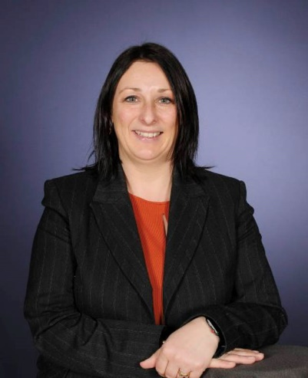

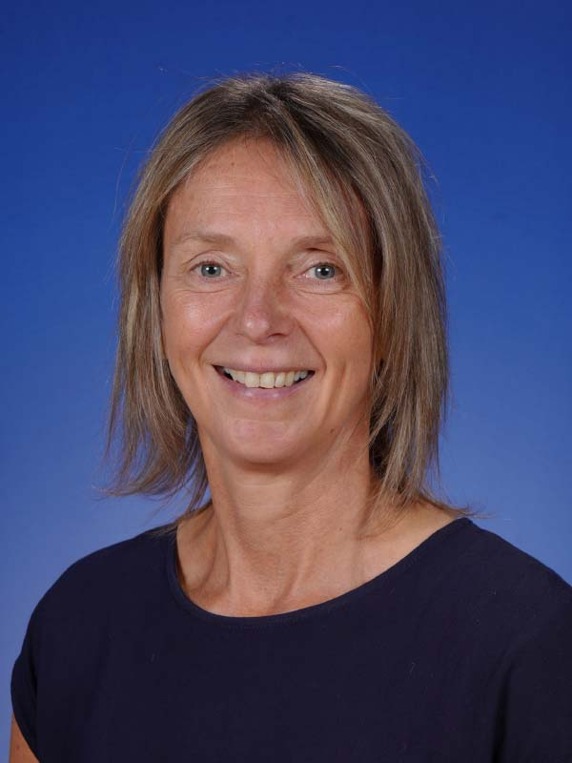
Pauline Walker - HT
Louise Winser – Careers Adviser
Jen Menzies - DHT
Outline
Skills Development Scotland
Senior Phase Curricular Structure(S4-S6)
Qualification Pathways
Reports and Course Choice Process
Questions

Slide 3
Louise Winser – Careers Adviser

Slide 4

LOUISE WINSER
CAREERS ADVISER
ROYAL HIGH
Mon – Fri
Block 2 – Block 7
Notes:
Skills Development Scotland is the national career agency for Scotland, careers advisers are employed by the agency to support people of all ages to make informed career decisions supply them with information, tools and resources to do this.
Not here to tell you what to do, or make them for you!

Slide 5
Support and conversations we may have in school
SDS careers advisers might speak to your young person about:
Finding out about their self, strengths and skills
Routes into careers including apprenticeships
Making decisions such as option choices
Building and developing networks
Different types of careers and how to research them
Help with creating CVs
Developing the types of skills that are useful in a job
Making applications and applying for courses
Notes:
SDS are in schools to help young people understand the world of work.
To help them develop and use their career management skills as they move throughout school.
We do this through our online service, My World of Work, and in person through our careers advisers in 1:1 meetings, groupwork sessions in PSE class, Assembles and Supporting Careers events in and out of school like UCAS event & Developing Young Workforces careers Fairs.
We start introducing careers to young people early in their school journey – to support young people to feel confident in making informed choices at later stages of school or at critical points such as option choices.
We never tell young people what to do but will work with them to help them discover what's right for them and everything they need to know to achieve this.

Slide 6

Options available after school
There are lots of routes available after school.
Making learning and career choices isn't just one step - it is many steps but remember there is no wrong path.
Employment
Self-employment
Apprenticeships
Volunteering
College
Other training options
University
Gap Year /Travel
Notes:
People can move between routes to support their progress, and for many careers there can be more than one route available.
Let’s explore these options in some more detail…

Slide 7
Modern
Apprenticeship
Graduate
Apprenticeship
NPA
Foundation Apprenticeship
Employment
NPA
NPA
Higher/Advanced Higher
National 4
National 5
University
HND
HNC
NC
College

Slide 8


Slide 9

Notes:
Discussions around the skills, qualities and attributes needed for particular careers, routes and pathways and how these can be achieved through certain subjects, courses and academies.

Slide 10


Where did last years school leavers go?
Initial School Leavers Destinations in Scotland
3 Months after leaving school in 2024 (3900 Edinburgh)
40.8%
Higher Education
26.4%
Further Education
Title
23.1%
Employment
5.4%
95.7%
Positive destinations Scotland
Training
4.0%
Unemployment
SOURCE: Scottish Government Summary Statistics for Attainment & Initial Leaver Destinations, No. 7: 2025 Edition, February 2025
Notes:
SCOTTISH FIGURES 2023-24. For other Local/School information or years see SOURCE.
THE REASON TO SHOW THIS SLIDE – ADVISE YOUNG PEOPLE, POST SCHOOL DESTINATIONS ARE COMPETATIVE AND EARLY PLANNING AND RESEARCH IS VITAL TO HELP YOU ACHIVE YOUR AIMS AND PLANS.
55,988 pupils left school in 2024 (+1,245 more leavers than in 2023). 95.7% entered positive destinations (down from 95.9%).
Just over 67% of leavers went into Further (FE) or Higher education (HE).
Higher Education: 40.8% - increased from 40.3% in 2022-23
Further Education: 26.4% - decrease from 26.6% in 2022-23
Employment: 23.1% - decreased from 24.3%in 2022-23
Unemployed: 4.0% - increased from 3.8% in 2022-23
NOTE: *Training (3.9%) incorporates voluntary work (0.6%) and Personal Skills Development (0.9%) figures.
NOTE: Unemployment includes Unemployed Seeking (2.2%), Unemployed Not Seeking (1. 9%) and Unknown (0.3%).
SOURCE: Scottish Government Summary Statistics for Attainment & Initial Leaver Destinations, No. 7: 2025 Edition, published 25 February 2025 https://www.gov.scot/publications/summary-statistics-for-attainment-and-initial-leaver-destinations-no-7-2025-edition/pages/section-3-school-leaver-initial-destinations/
Also see: RSA Data Matrix ‘Skills Supply’ for positive and negative destination figures by local authority

Slide 11
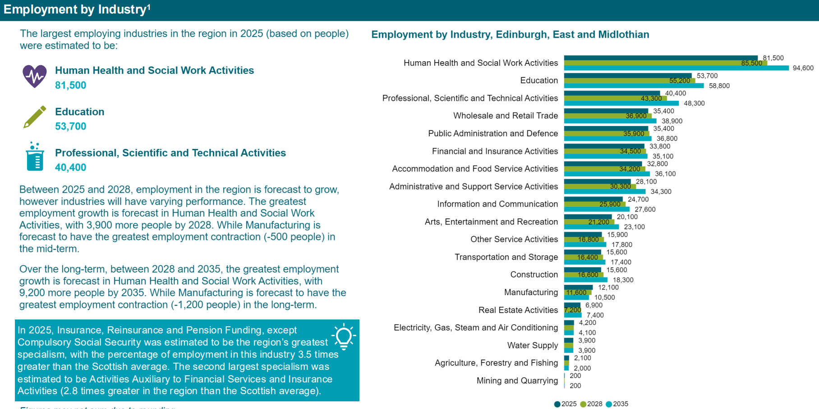
www.skillsdevelopmentscotland.co.uk/media/z4ul3fyu/rsa-city-region-report-edinburgh-and-south-east-scotland.pdf
Notes:
We can’t guarantee the future but cane use the valuable careers Data from our labour market research published via SECTOR SKILLS ASSEMENTS
www.skillsdevelopmentscotland.co.uk/media/z4ul3fyu/rsa-city-region-report-edinburgh-and-south-east-scotland.pdf

Slide 12


For a careers appointment
Drop into Library - Careers Pod to get a slot
Email : Louise.winser@sds.co.uk

Slide 13


Slide 14


Slide 15
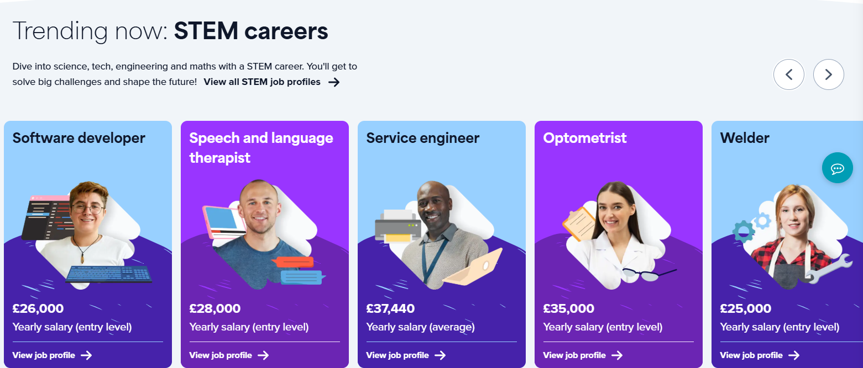

Slide 16


Notes:
Get paid for working and work towards a qualification (SCQF L5 to L12)
Gain practical skills developed in the workplace leading to a nationally (and industry) recognised qualification
Delivery of training and assessment depends on sector: entirely on the job training or combination of formal taught learning and on the job training
WHILE STILL IN SCHOOL ( S5/S6)
12 different Foundation Apprenticeships available to study at SCQF Level 6 . That's the same level as a Higher. They include Business Skills, Engineering and Creative and Digital Media.
There are also 3 available at SCQF Level 4/5 at some schools as part of a pilot. That's the same level as a National 4 or National 5. They are Automotive, Construction and Hospitality.

Slide 17
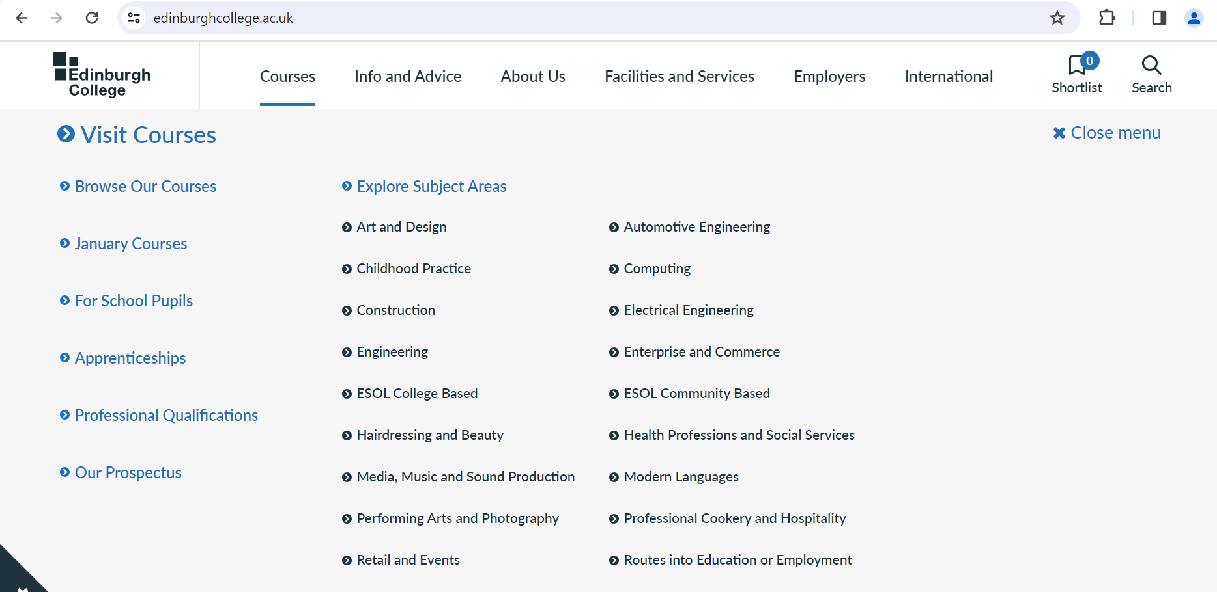
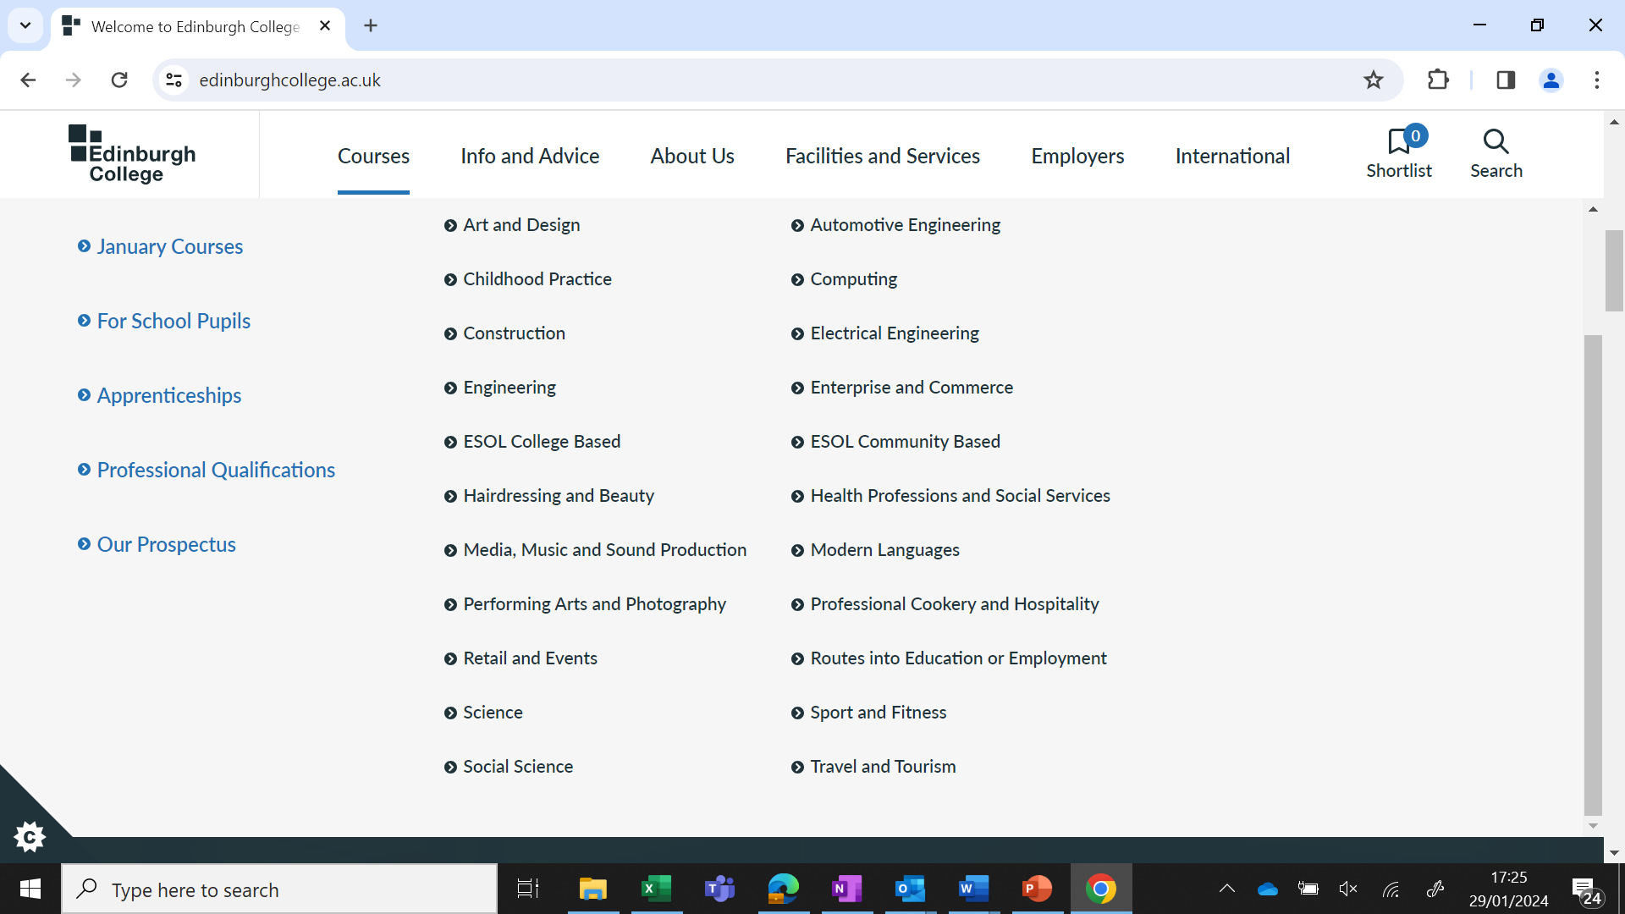
Notes:
4 Campus – 1 website

Slide 18


Slide 19




Slide 20
Qualification Pathways

Slide 21


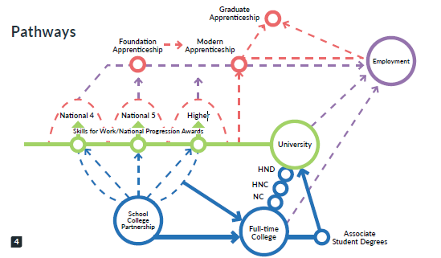
Variety of Options

Slide 22
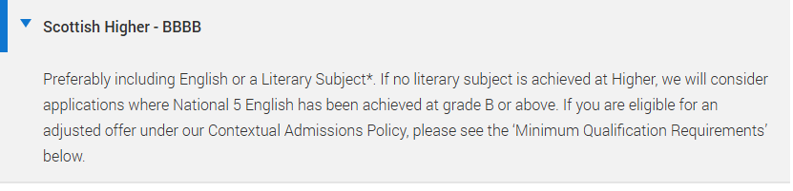
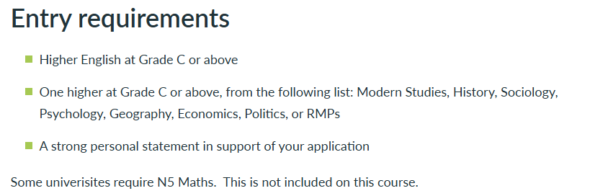
Search - UCAS
The Big Picture: Pathways and Qualifications
Edinburgh Napier – Degree in Criminology
Full-time courses | Edinburgh College
Edinburgh College – HNC in Social Science

Slide 23


Slide 24
Alternative pathways from S3 into the Senior Phase
Subject Name
Applications of Mathematics (NAT5)
Barbering NPA (45)
Computer Games Development (45)
Criminology NPA (45)
Fashion & Textile: (NAT5)
Hospitality Barista Skills (45)
Make-up and Eye Treatments NPA (45)
Photography (45)
Sport Fitness (45)
Travel & Tourism (NAT5)

Slide 25

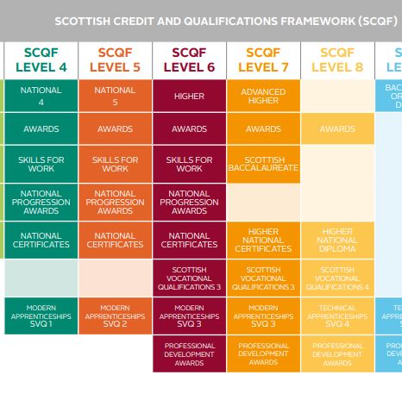
Our Curriculum Pathways – The Royal High School
nutshells_pathway_E.pdf

Slide 26
NW Consortia- Offer
NW Locality of Edinburgh
8 schools
Model 1: Hybrid (Online/In
Person)
Model 2: Fully In Person
Opens pathways not
otherwise offered
2026/2027 offer being
finalised
Subject |  |  |  |  |  |  | Level |  |  |  | Model |  |  | School
French |  |  |  |  |  |  | Adv Higher |  |  |  | Hybrid |  |  | Craigroyston
Graphic Communication |  |  |  |  |  |  | Adv Higher |  |  |  | Hybrid |  |  | St Augustines
Mandarin (Simplified) |  |  |  |  |  |  | Adv Higher |  |  |  | In Person |  |  | Broughton
Mathematics of Mechanics |  |  |  |  |  |  | Adv Higher |  |  |  | In Person |  |  | Broughton
Spanish |  |  |  |  |  |  | Adv Higher |  |  |  | In person |  |  | Queensferry
Creative & Digital Media |  |  |  |  |  |  | Foundation Apprenticeship |  |  |  | In Person |  |  | Craigroyston
Economics |  |  |  |  |  |  | Higher |  |  |  | In Person |  |  | Craigmount
Philosophy |  |  |  |  |  |  | Higher |  |  |  | Hybrid |  |  | Trinity
Politics |  |  |  |  |  |  | Higher |  |  |  | In Person |  |  | Trinity
Computing Technologies |  |  |  |  |  |  | level 6 |  |  |  | In Person |  |  | Forrester
Customer Services |  |  |  |  |  |  | level 6 |  |  |  | In Person |  |  | Forrester

Slide 27
Senior Phase Curriculum Structure

Slide 28
Senior Phase Curriculum Structure
S3
English (4)
Maths (4)
Science (3)
Modern Languages (3)
Expressive Arts (3)
Social Studies (3)
Technologies (3)
Free Choice (3)
Academies (2)
Physical Education (2)
Social Education (1)
Religious Education (1)
S4
Choice 1 (4)
Choice 2 (4)
Choice 3 (4)
Choice 4 (4)
Choice 5 (4)
English (4)
Maths (4)
Physical Education (2)
Social Education (1)
Religious Education (1)
S5
Choice 1 (4/6)
Choice 2 (4/6)
Choice 3 (4/6)
Choice 4 (4/6)
Choice 5 (4/6)
Academy (1)
Social Education/Study (1)
S6
Choice 1 (4/6)
Choice 2 (4/6)
Choice 3 (4/6)
Choice 4 (4/6)
Academy (1)
Social Education/Study (1)

Slide 29
What this might look like - by the end of S6
S4
S5
S6
2023
2024
2025
Course Name
Results
Course Name
Results
Course Name
Results
Mathematics
N4:P
Applications of Mathemati
N5:C
Applications of
HI:C
English
N5:B
English
HI:D
English
HI:B
Biology
N4:P
Biology
N5:C
Biology
HI:C
Physical Education
N5:A
Physical Education
HI:B
Physical Education
AHI:B
History
N5:C
Modern Studies
N5:C
Practical Cookery
N5:A
Business Management
N5:D
Business Management
HI:C

Slide 30
Senior Phase Reports & Course Choice

Slide 31
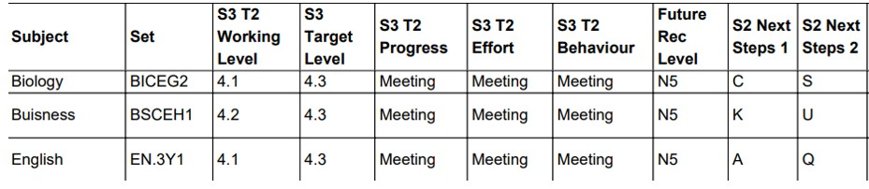
Report Overview – Future Rec Level
S3 Snapshot:
Senior Phase Snapshot:

Slide 32
Course Choice Considerations: S3 into S4
Current S3 Subjects |  |  | S4 Subjects Choices
 | Subject | Level Next Year recommended | Subject | Level | Rank order
1 | English | Nat 5 | English | Nat 5 | 1
2 | Maths | Nat 4 | Maths | Nat 4 | 2
3 | Business Management | Nat 5 | Physical Education | Nat 5 | 3
4 | Graphic Communication | Nat 5 | Graphic Communication | Nat 5 | 4
5 | French | Nat 5 | Geography | Nat 5 | 5
6 | Geography | Nat 5 | Physics | Nat 4 | 6
7 | Physical Education | Nat 5 | Business Management | Nat 5 | 7
8 | Physics | Nat 4 | French | Nat 5 | Reserve

Slide 33
Course Choice Considerations: S4 into S5
Current S4 Subjects |  |  | S5 Subjects Choices
 | Subject | Recommended Level of study | Subject | Level | Rank order
1 | English | Higher | English | Higher | 1
2 | Maths | Nat 5 | Art and Design | Higher | 2
3 | Art and Design | Higher | Graphic Communication | Higher | 3
4 | History | Higher | Music | Higher | 4
5 | Graphic Communication | Higher | Physics | Higher | 5
6 | Music | Higher | History |  | Reserve
7 | Physics | Higher

Slide 34
Course Choice Considerations: S5 into S6
Current S5 Subjects |  |  | S6 Subjects Choices
 | Subject | NQ Level Next Year | Subject | Level | Rank order
1 | Classics | Adv H | Classics | Adv H | 1
2 | English | Higher | English | Higher | 2
3 | Geography | Nat 5 | Modern Studies | Higher | 3
4 | Modern Studies | Higher | PE | Higher | 4
5 | Travel and Tourism | Level 6 | Geography | Nat 5 | Reserve

Slide 35
S6 Experience
Pupils in S6 must select a minimum 4 options (or 3 Adv H)
AH courses will only run in person if we have enough pupils
selecting (15 pupils minimum)
In S6 you start a course then you must finish the course unless you have exceptional circumstances

Slide 36
Confirmation of Course Choice- S4 Example
This is an E-mail Confirmation from The Royal High School To: the Parent or Carer of Steven Raeburn (S4)
Dear Parent or Carer,
This is to confirm that you have requested the following choices: 1=Engli NAT5
2=Maths NAT5
3=PE N54
4=DM
N54
5=Geogr N54 6=Physc NAT4
7=Bsnss R=Frenc
N54 N54
Please do not reply unless there is an issue with your child's choices.

Slide 37
Confirmation of Course Choice- S5 Example
This is an Email Confirmation from The Royal High School To: the Parent or Carer Steven Raeburn (S5)
Dear Parent or Carer,
This is to confirm that you have requested the following choices:
1= PE H
S5/6
2=ModST5S
5/6
3=Maths5S
5/6
4=Engli5S5/6 5=PrWwo N54 6=S56 Free F 7=S56 Free G R= Geogr L54
Please do not reply unless there is an issue with your child's choices.

Slide 38
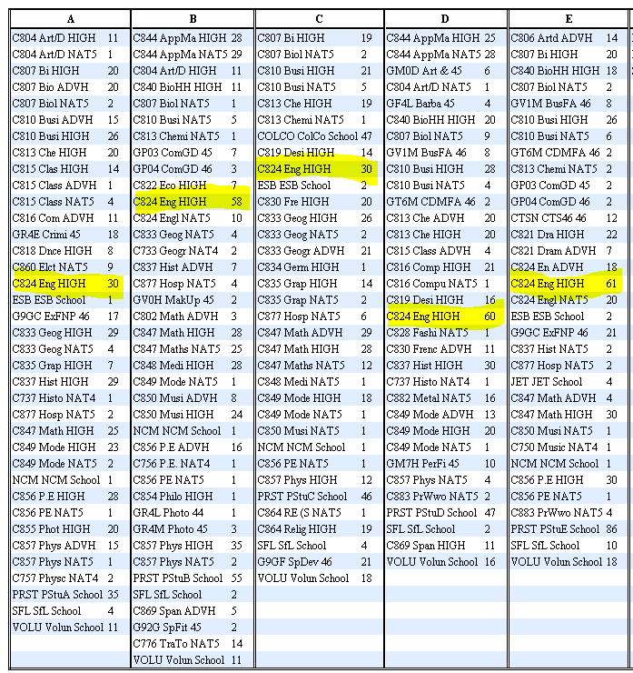
What we do with the subject choices

Slide 39
Considerations
A course may not run if not enough pupils choose it
Your child may have a unique combination of subjects that don’t work when their choices are moved into columns for Timetabling.

Slide 40

Senior Course Choice Timelines
Mon 12th January | S3-S6 Parents Course Choice Information Evening
Mon 19th January | S3 Future Recommendation & Tracking Report
Tue 3rd February | S3 Parents Evening
Thurs 5th February | S3 Course Choice with Guidance
Fri 6th February | S3 Course Choice with Guidance
Mon 9th February | S4/5/6 Presentation Levels & Future Recommendation Report
Wed 11th February | S4 Parents Evening
Tue 24th February | S4 Course Choice with Guidance
Wed 25th February | S4 Course Choice with Guidance
Thurs 26th February | S5/6 Parents Evening
Mon 2nd March | S5 Course Choice with Guidance
Tue 3rd March | S5 Course Choice with Guidance
Thurs 20th March | S4-6 Final Tracking Report issued (WG/SQA Estimate)

Slide 41
Depute Headteachers
Angles & Picts: Jennifer Menzies Jennifer.Menzies@royalhigh.edin.sch.uk
Brits & Gaels: Nicola Casey Nicola.Casey@royalhigh.edin.sch.uk
Celts & Scots: Maxine Hughes Maxine.Hughes@royalhigh.edin.sch.uk
Pupil Support Depute: Lewis Whale Lewis.Whale@royalhigh.edin.sch.uk
Curricular Leader Support for Pupils (Guidance teacher)
Angles: Claire Devlin (Monday-Wed) Claire.Devlin@royalhigh.edin.sch.uk
Angles: Kerry Janetta (Thursday-Fri) kerry.jannetta@currie.edin.sch.uk
Brits: Scott Rodger Scott.Rodger@royalhigh.edin.sch.uk
Celts: Alexander Hagart alexander.3.hagart@royalhigh.edin.sch.uk
Gaels: Shauna McCallion shauna.mccallion@royalhigh.edin.sch.uk
Picts: Robert Watson robert.watson@royalhigh.edin.sch.uk
Scots: Hannah Sim (Mon -Wed) Hannah.Sim@royalhigh.edin.sch.uk
Scots: Amy Hogg (Thurs-Fri) amy.hogg@royalhigh.edin.sch.uk
Curricular Leader Support for Learning
Deborah.Hislop@royalhigh.edin.sch.uk
Skills Development Scotland (SDS) Careers Advisor
Louise Winser Louise.Winser@sds.co.uk

Slide 42
Useful Website Links | Description
My World of Work | Career suggestions tailored to you
https://daydreambelievers.co.uk/qualification | The course is centred around pupil creativity, problem solving and critical thinking: metaskills that will be required of a future workforce.
The Complete University Guide | Everything you need to know about all universities in the UK
UCAS | University applications
Leaps | Advice, encouragement and support for applying for higher education
Edinburgh College | Edinburgh College
https://www.sqa.org.uk/sqa/45625.html | The Scottish Qualifications Authority
https://www.npfs.org.uk/downloads/ | Helpful resource for parents which explains the National qualifications.

Slide 43

Questions?

