Slide 1

S3 – S6 Pathways in Maths

Slide 2
S3 – S6 Pathways in Maths
Maths vs Apps of Maths
2. Pathways at RHS
3. Pathways beyond RHS

Slide 3
N5 Apps
N5 Maths
Numeracy
Statistics
Geometry
Graphical Data and Probability
Algebraic
Trigonometric
Numeracy
Statistics
Geometry
Graphical Data and Probability
Financial (money)
Measurement

Slide 4
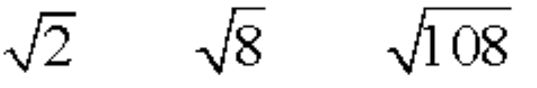
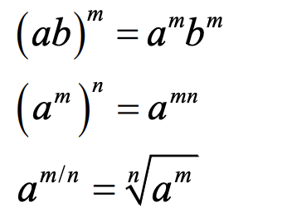
N5 Apps
N5 Maths
Numeracy
Fractions, Decimals and Percentages
Distance, Speed, and Time
Measurement Scale
Numeracy
Surds
Indices
Fractions & Percentages

Slide 5
N5 Apps
N5 Maths
Develops mastery of S1 – S3 Maths number, geometry and measurement, with some new content.
Assumes mastery of S1 – S3 Maths number, geometry and measurement
Students learn to apply this content in new and unfamiliar contexts
Students learn to build more complex mathematical skills based on number, geometry, algebra and trigonometry

Slide 6
N5 Apps
N5 Maths
Recommended for students where progress data shows some consolidation of S1 – S3 Maths required.
Recommended for students where progress data shows consolidation of most S1 – S3 Maths
N4 Apps is recommended for students where much consolidation of S1 – S3 Maths required

Slide 7
Higher Apps
Higher Maths
Statistical and Probability
Statistics and Data
Statistics with Correlation and
Linear Regression
Financial and Money
Use of R Studio statistical software
Algebra
Trigonometry
Calculus
Geometry

Slide 8
Higher Apps
Higher Maths
Statistics focussed course
Suitable for humanities and some science courses
'Pure' mathematics course
Required for engineering, computing science, and some science courses

Slide 9
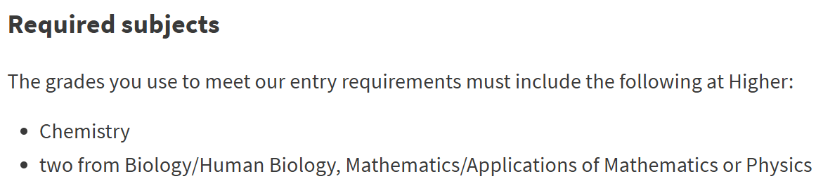

University of Edinburgh

Slide 10

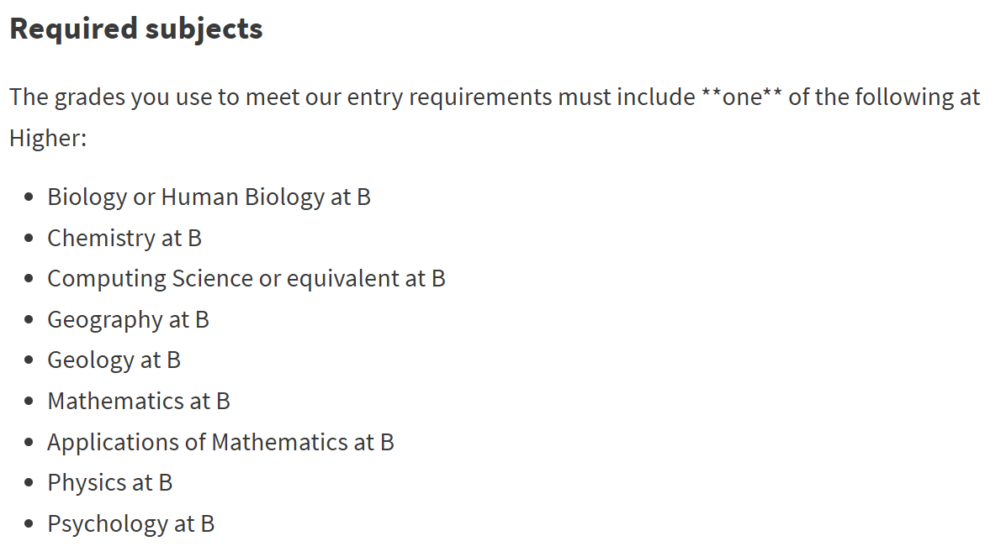

University of Edinburgh

Slide 11

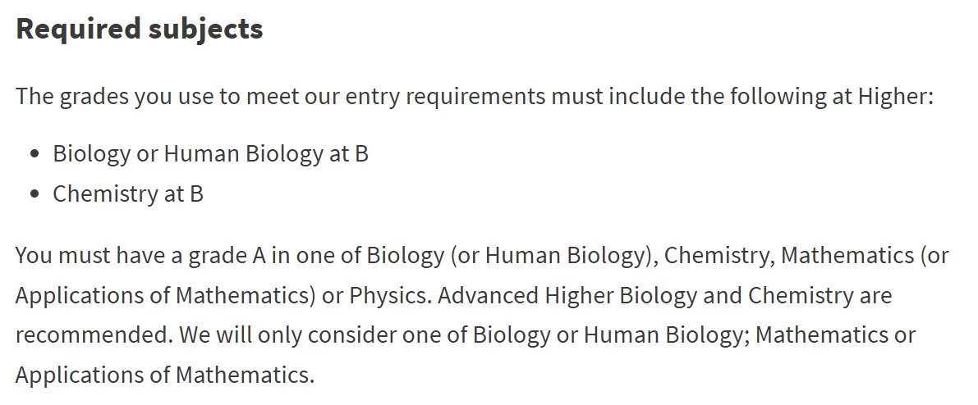



University of Edinburgh

Slide 12
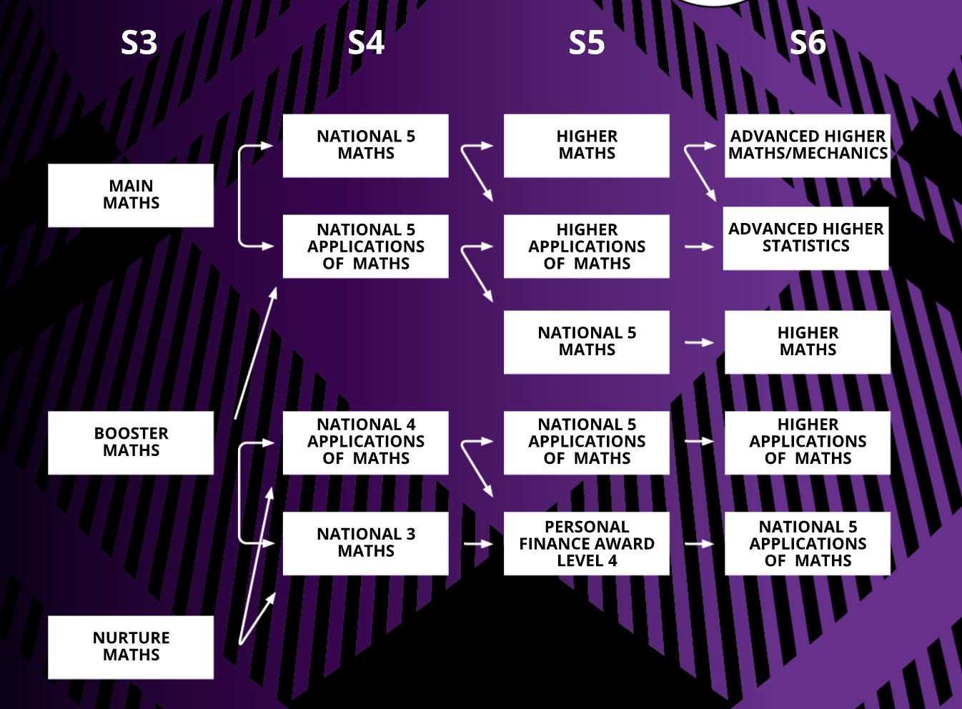






Slide 13






Slide 14










Slide 15








Slide 16
S3 – S6 Pathways in Maths
Further consolidation of S1 – S3 required?
2. Best pathway to attempting a Higher in S5?
3. Pathways beyond RHS

Slide 17
Q&A

