Slide 1

How to Pass …
Mathematics
Kamran Sikander
CL Maths & Numeracy

Slide 2
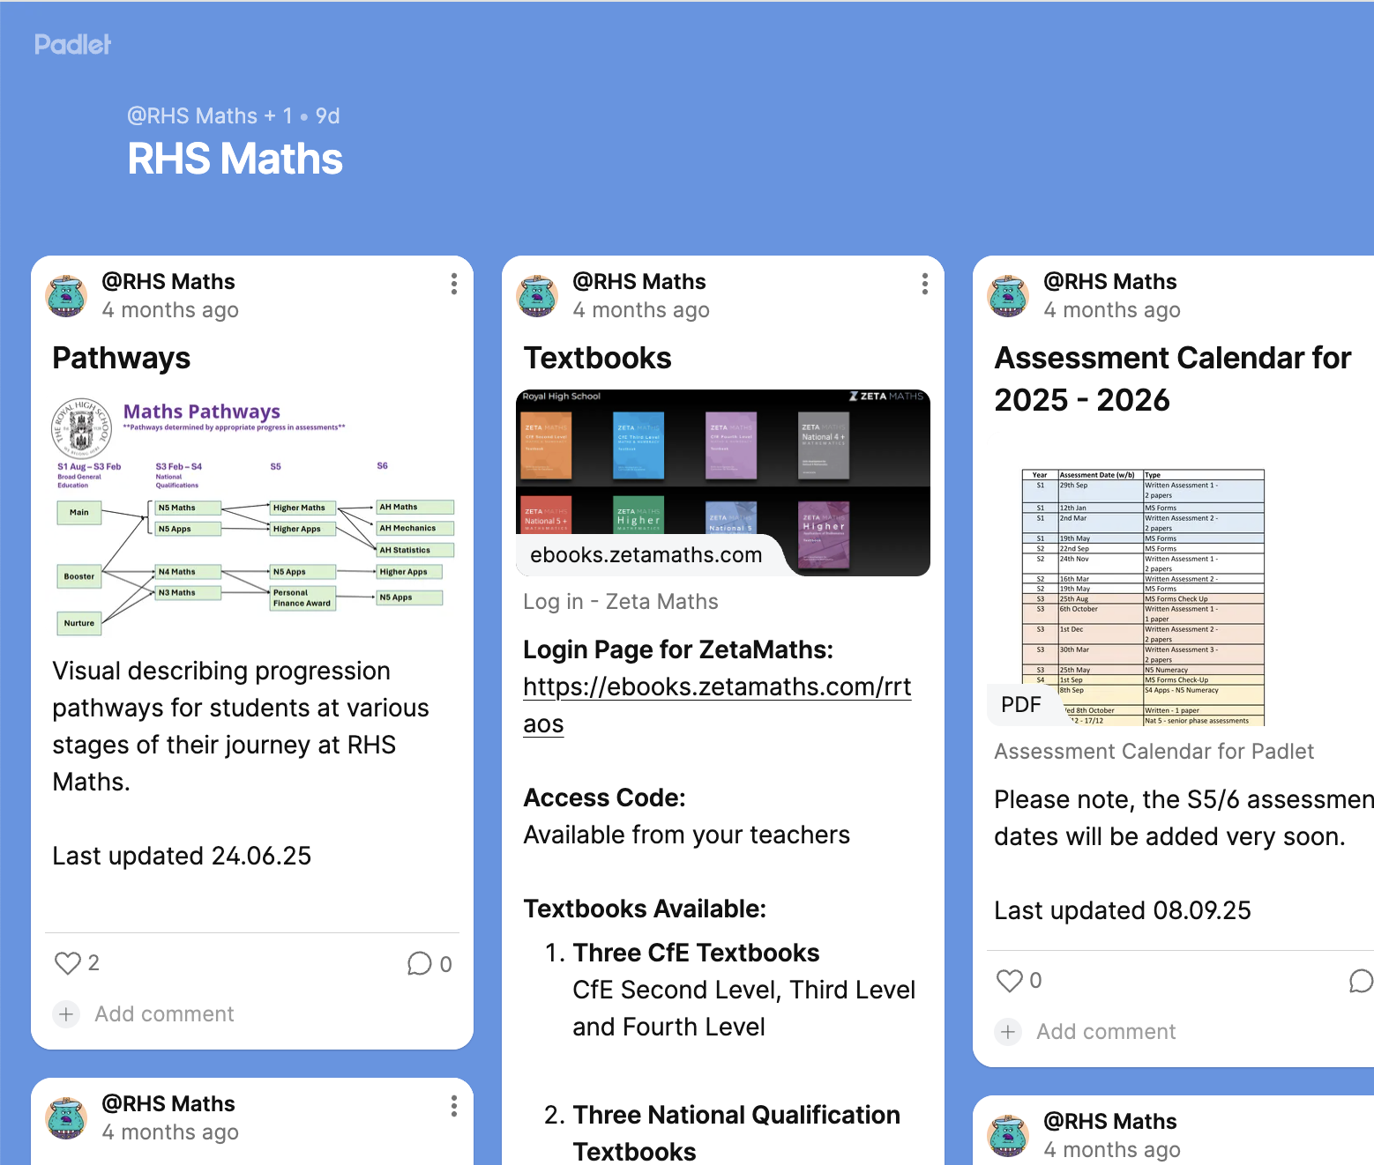
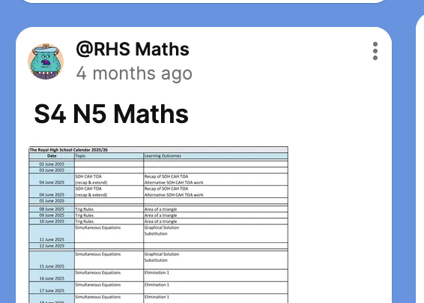
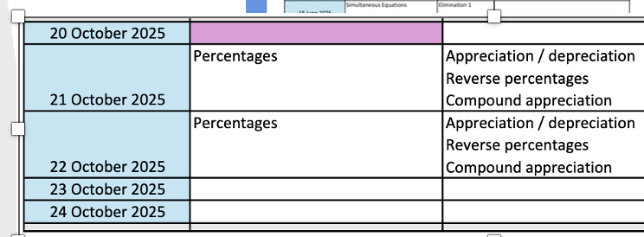
1. What am I learning?
Topic list
Padlet

Slide 3


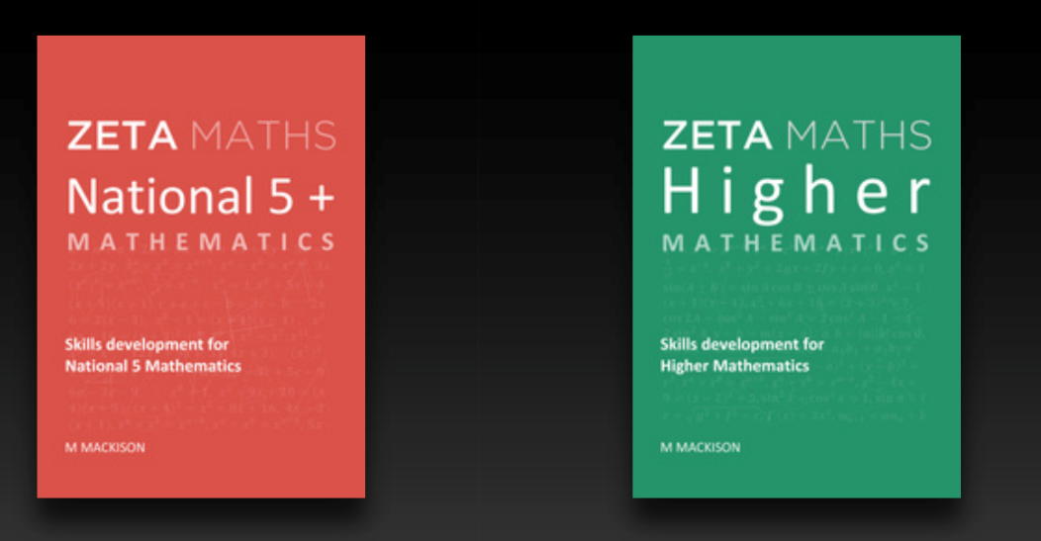
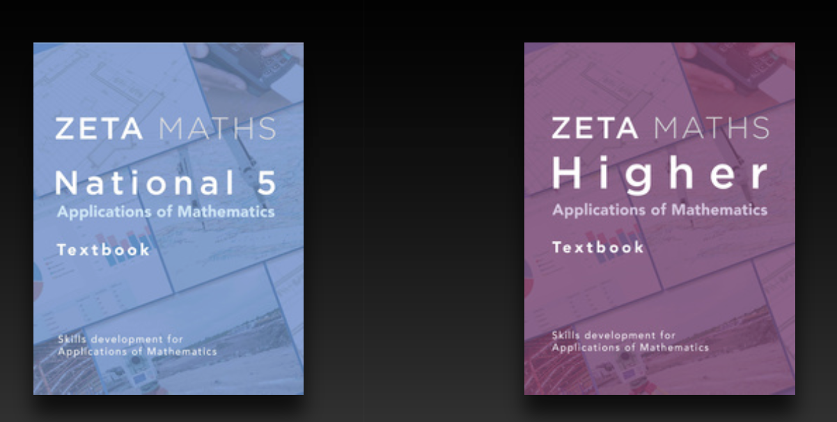
2. Reviewing Core Skills
Textbooks for all level
Zeta Maths

Slide 4
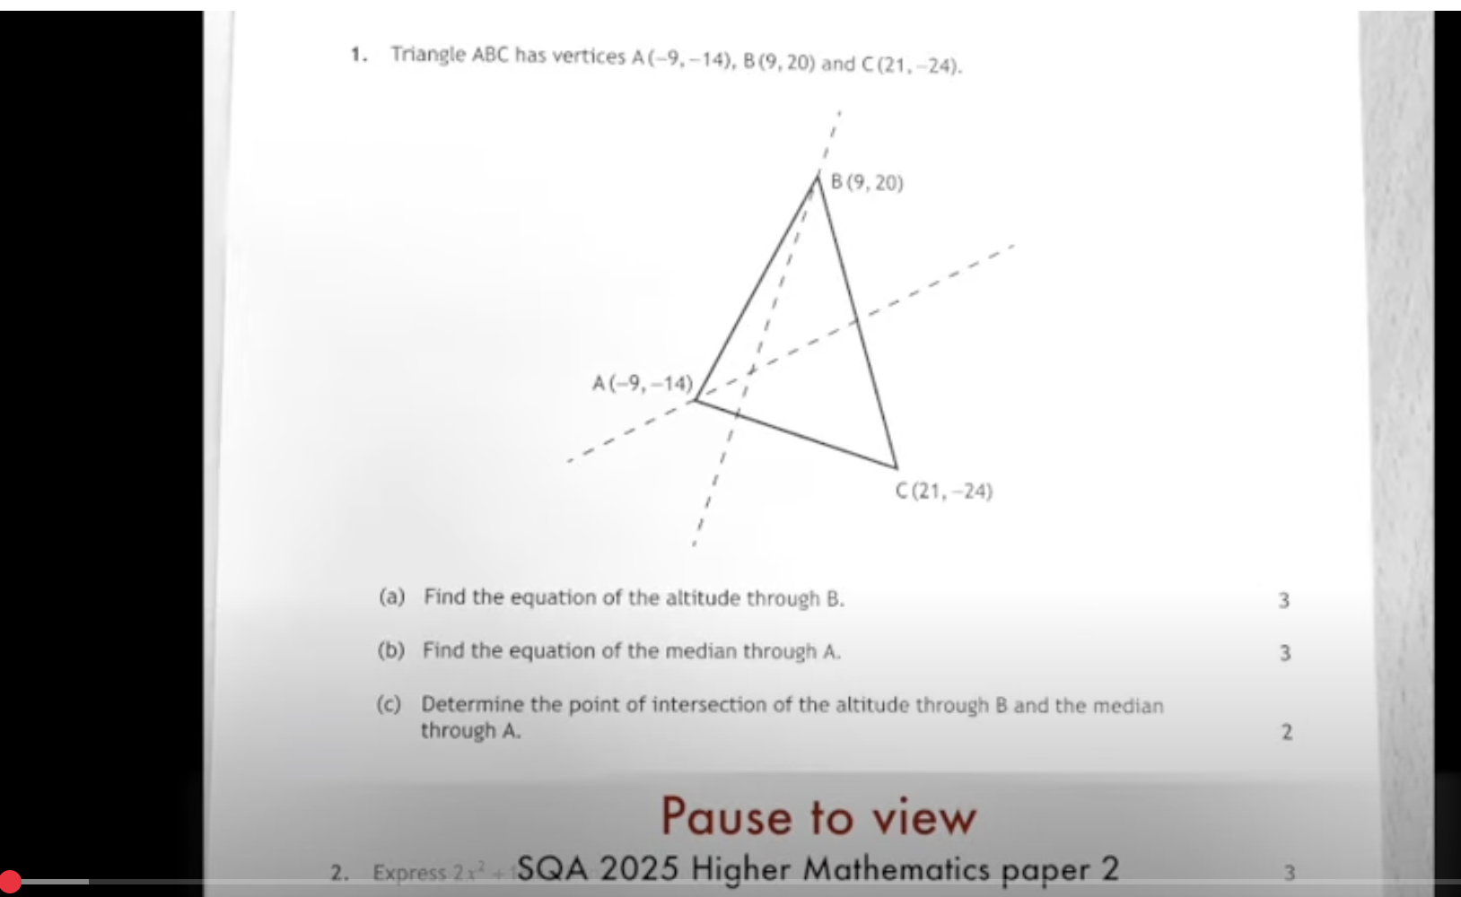
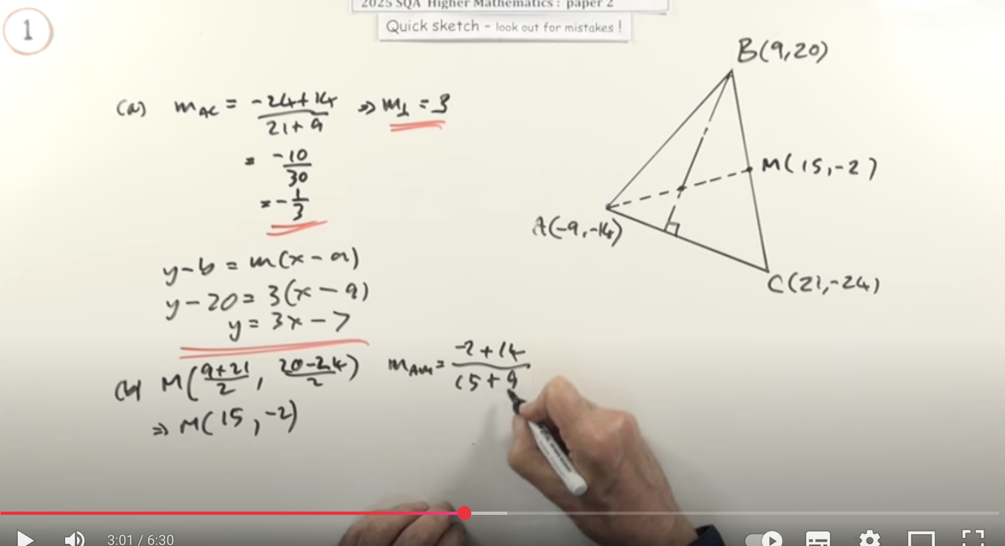

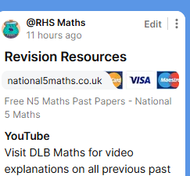
3. Exam prep
YouTube – DLBMaths
Past Papers
Past Papers
Past Papers
Revision Resources

Slide 5
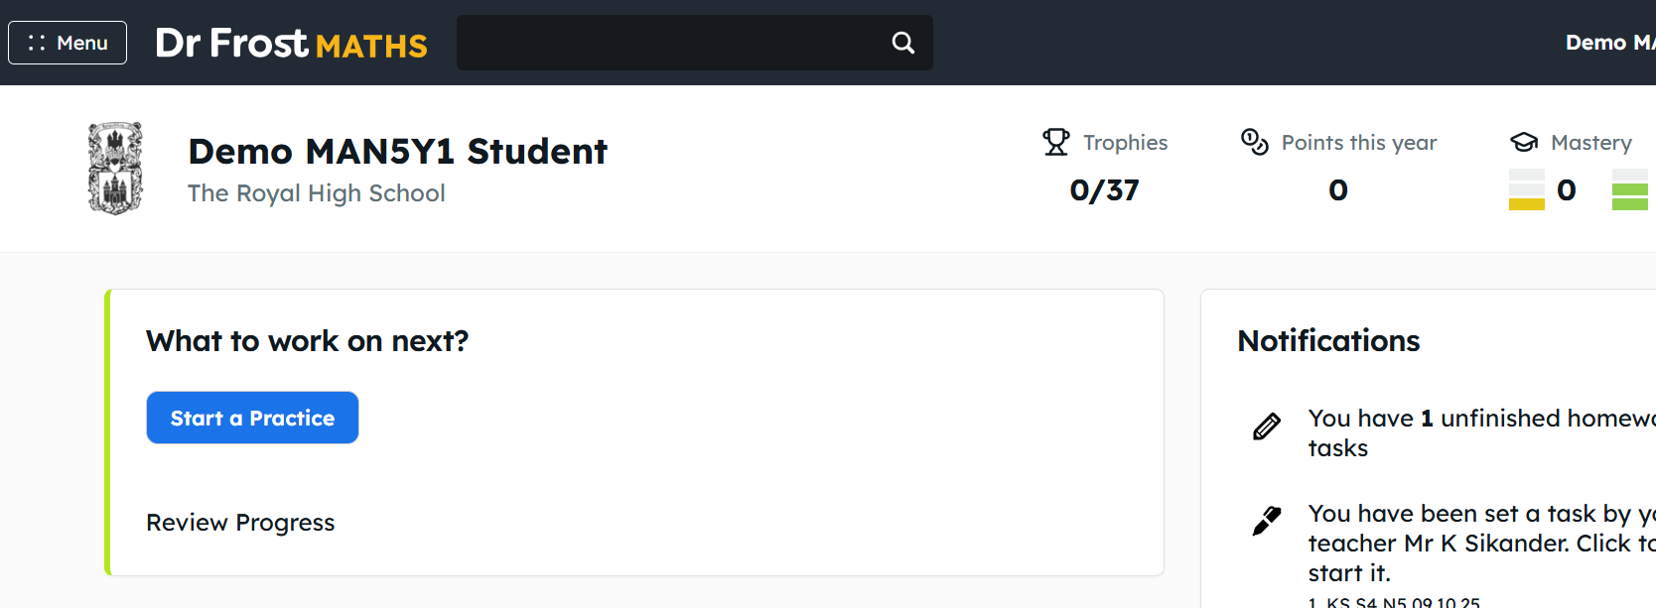

4. Dr Frost - Homework

Slide 6
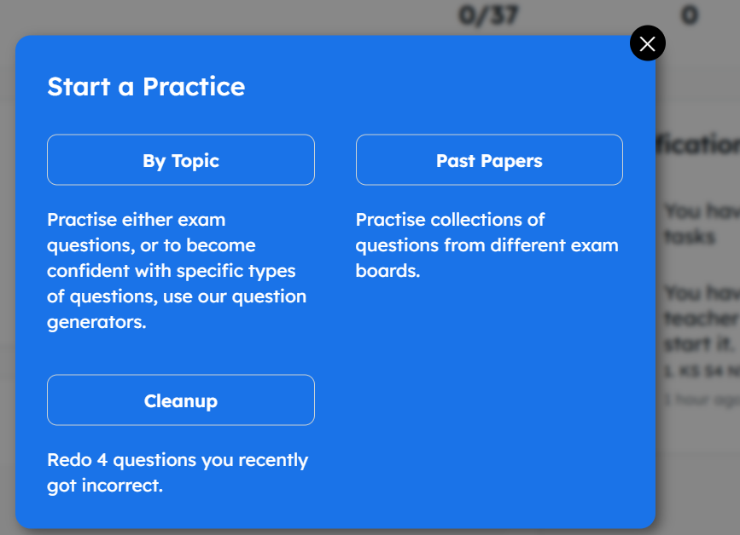
Dr Frost

Slide 7
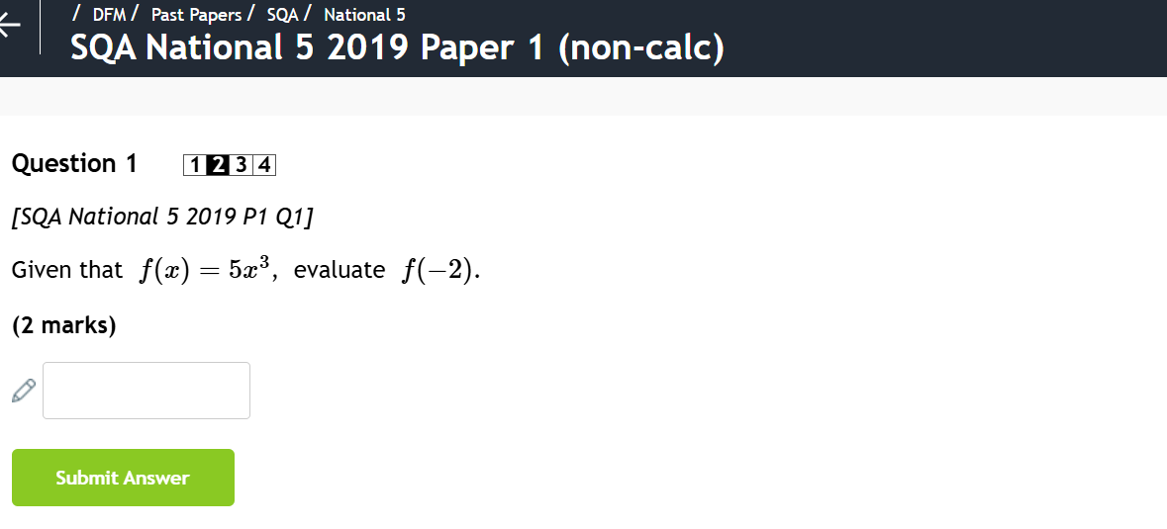
Dr Frost

Slide 8
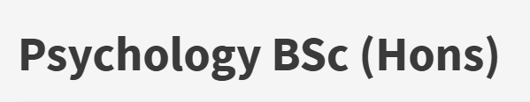
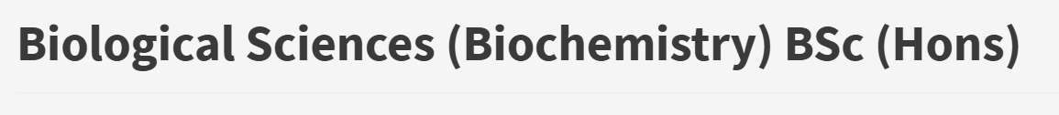
5. Higher Applications of Maths
Statistics focussed course
Alternative to Higher Maths for many university courses
University of Edinburgh accepts as alternative to Higher Maths for:

Slide 9
Summary
1. Padlet – topics
2. Zeta Maths
3. Revision Links - YouTube & Websites
4. Dr Frost
5. Higher Apps

