Slide 1

How to help your child get the most out of studying: Working smarter not harder
Notes:
.

Slide 2
Aims of this evening
What can students do to improve their memory, mood and concentration?
What does research tell us about how to study more effectively – to really help embed knowledge?
Which techniques really work, and which don’t?
How can you as families support your child’s study and help improve their study habits?

Slide 3

I learn best when I…..
Read over my notes lots of times
Highlight key points
Teach someone else
Write notes out again in a different form e.g. mind maps
Test myself using flashcards/quizzes
Do past paper questions
Cram the knowledge just before an exam, so it’s all fresh in my head
Revise a topic several times over the course of a few weeks
Can you remember how you studied? Pick as many as applied to you!

Slide 4
What the research shows doesn’t work (without doing anything else)
There is no one way to revise, but there is a lot of research to show that some of the most common and popular methods are not the most effective. For example:
Just re-reading notes or class slides
Re-watching recordings without doing anything with them
Just highlighting notes
Summarising WHILST looking at notes
Cramming information in a short time before the assessment

Slide 5
So what does work?
This next section will have a look at some of the key strategies recommended by Cognitive Psychologists to help support your young people.
Key things to keep in mind to best support young people:
- The physical school environment and construct hasn’t really changed for 200 years…but the business of Teaching and Learning has.
- Digital technology is fundamental to their success in learning, and a crucial future skill.
- Exams and course work bear some similarities to the past but in many cases look different to ‘traditional’ exams.
- Social lives are driven by technology to a greater or lesser extent depending on the young person and is a key factor to consider in relation to effective study.

Slide 6
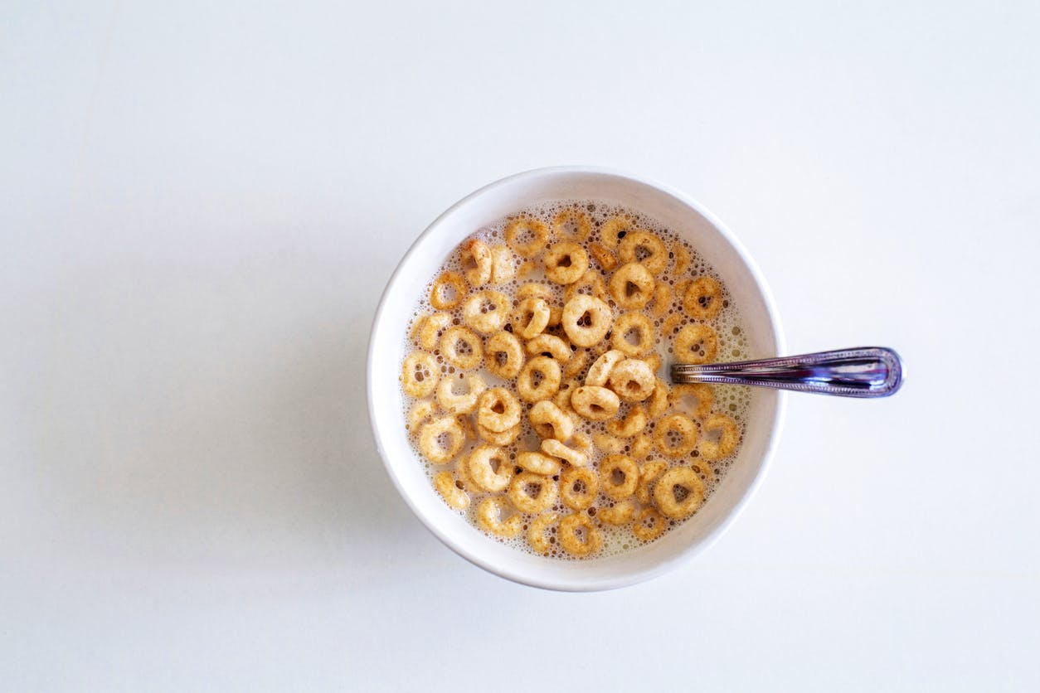



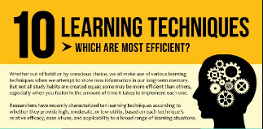
The Science of Revision: What Cognitive Psychologists tell us works
EAT WELL: Research finds that skipping breakfast significantly reduces attention/recall ability
SLEEP WELL: Critical role in memory consolidation-brain backs up short term patterns and creates long term memories.
EFFECTIVE WORK/BREAK BALANCE: slogging away for hours is likely counter effective – stragetise the smarter way to work
STUDY ENVIRONMENT: where is study happening? What are the distractions (phones/digital)
EFFECTIVE STUDY TECHNIQUES: What are the best techniques

Slide 7
EAT WELL
Don’t skip meals and eat before you start to study – nutrition advisers state that small meals often can be a good way of keeping up energy levels.
‘Brain food’ – it’s a thing! Food with a high protein content has been proven to help keep the brain mentally alert.
Plenty of fruit and veg
Limit caffeine intake – not just coffee, think about what’s in your soft drinks.
Avoid sugar? Life is definitely for living…but sugar in moderation and keeping food/snacks high in nutritional content will help concentration.

Slide 8
SLEEP WELL
The science of ‘Sleep Hygiene’
It’s all about routine…
Stick to a bedtime routine – aim to go to sleep at the same time each evening
Plan with your friends to not be online, especially around exam season - that way you won’t get FOMO. LEAVE PHONES/IPADS OUT OF REACH
Try to stop digital revision an hour before you sleep and detox from the blue light.
End your day screen free – no tv either. Reading is a great way to relax your mind into sleep.
https://www.bbc.co.uk/bitesize/articles/zd3pywx

Slide 9
EFFECTIVE WORK/BREAK BALANCE:
Set goals and be realistic
Break it up – 30 minute of study then 10 minutes of distraction – check your phone, a wee walk, glass of water etc (adjust the time as suits the challenge)
On the approach to assessments or exams have a calendar plan.
Senior Phase Assessment Calendar: https://royalhighschool.co.uk/senior-phase-assessment/
Senior phase assessments and arrangements recording: https://royalhighschool.co.uk/presentations-recordings/
My SQA: https://www.sqa.org.uk/sqa/68908.html
STUDY SMART: https://www.bbc.co.uk/bitesize/articles/zkyts82

Slide 10

EFFECTIVE STUDY TECHNIQUES

Slide 11

The key messages from research… https://www.bbc.co.uk/bitesize/articles/zkpj96f
Psychologists recommend that to improve your memory you need to make your brain work- they call this ‘retrieval practice’
Vital to re-organise the information in some way- notes of your notes, making connections, practising writing answers- helps get material lodged in memory.
Spacing out revision is the most effective revision technique: 1 hour a day over 10 days on a topic is better than 10 hours in one day

Slide 12
Strategy 1: Getting started
First step- work out what you need to know - use lists given by teacher/lists of course content on QS website.
Find any gaps in notes- go to OneNote/Teams, ask teacher.
Identify areas of weakness
When preparing for assessments, come up with a realistic revision plan. Switching between different topics/subjects rather than focusing on one topic/ subject during a revision session works best.
Support at home: Go through the list of content for each topic with them and help them ‘traffic light’ how they feel about each topic. Any ‘Reds’-encourage them to start with these topics- this gives more time to keep going over them.
Notes:
.

Slide 13
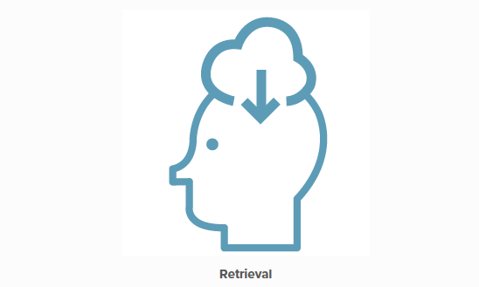
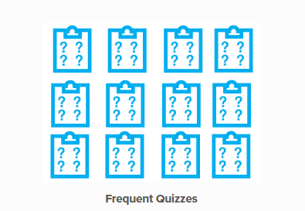
Strategy 2: Testing yourself
Practice ‘retrieving’ information: test yourself frequently.

Slide 14
Strategy 2: Testing yourself
Make notes, flashcards, mindmaps, diagrams, glossaries
https://www.bbc.co.uk/bitesize/articles/zhdrkhv
THEN test- quizzes, multiple choice questions, past papers, summaries without looking at notes.
Don’t always have to write it- test yourself by speaking answers out loud can work too
Keep revisiting the same questions/tests if you didn’t do well.
Support at home: Test them on what they’ve learned- make up quizzes or get them to make up quizzes for you to give them. Try to ask unexpected questions to check for understanding.

Slide 15
Strategy 3: Finding gaps
Big advantage of frequently testing yourself is it helps you find gaps in your knowledge.
Key part of improving study skills is improving metacognition- knowledge about own knowledge
Goal is to improve this metacognition for each subject-and being able to identify specific areas for improvement
Support at home: after testing/doing past paper practice, identify any areas of difficulty – and why it didn’t go well. Structure of Q? Memory? Not understanding? Didn’t read Q?

Slide 16
Strategy 4: Past papers
Vital part of revision process at home-too often, left till last minute or not done at all
Practising sample answers to past exam questions can help train your brain to retrieve information- do same Q more than once!
Identifying the command words of the question and knowing how to answer the different types is a huge part of success.
Support at home: Go to https://www.sqa.org.uk/pastpapers/findpastpaper.htm. Time them doing questions and then go through the marking scheme to see how to improve. Close to the exam, time them doing a full past paper to help manage timings. Encourage them to hand in extra questions to teachers-happy to help.
Subjects will supply students with help sheets on how to answer different types of questions and help recognise command words- you could test them on this.

Slide 17

Strategy 5: Teaching others
After testing yourself, teach the material to someone else- or even the mirror!
Found to help aid memory and recall- “the Protégé Effect”.
Teaching someone else requires you to learn and organise your knowledge in a clear and structured manner.
Support at home: get them to teach you a topic. Try doing it several times- leaving a longer gap between each time you do it. So an hour, a day, a few days, a week.

Slide 18
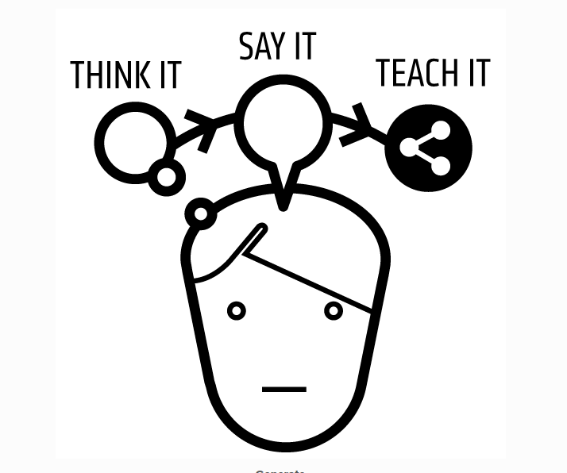
The impact of teaching others

Slide 19
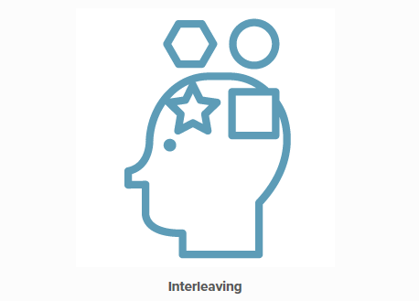

Strategy 6 – Spaced repetition
Spaced Practice
Cutting up revision into smaller chunks and spacing it out over a period of time is the suggested by research as the best strategy to adopt when planning for assessments.
For example, with six hours to prepare for an assessment in a week’s time, here is a suggestion with regards the best way to space out the revision.
https://www.bbc.co.uk/bitesize/articles/znj4dnb
Interleaving
As with spaced practice, leaving gaps between studying is very effective. When studying multiple topics, mixing up the material you study adds to its impact.

Slide 20
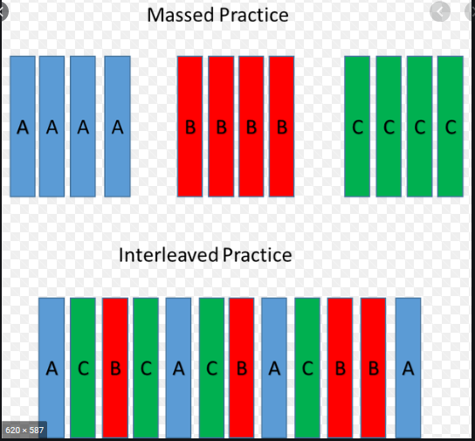
Example of interleaving

Slide 21
Strategy 6: Spaced Repetition
"A century of research has shown that repeated testing works.”
Support at home: Use flashcards organised in a box. Set up a schedule revising the cards in each of the sections in your box. If they answer a card correctly, put it into a section to revisit less frequently in the future, whereas if the answer is wrong, move the card into a section scheduled for frequent visits.

Slide 22
Other ways you can support your child’s study
Find relevant films/TVprogrammes online/YouTube. There are also lots of revision videos on YouTube made by teachers- but be careful they are relevant and they do something with them.
BBC Bitesize: online resource- covers N5 and Higher, good for some subjects but doesn’t necessarily have everything Provides info and tests online
Little incentives: can help keep up motivation
Chunk revision: If it’s too late to do spaced out revision, then encourage them to do short thirty-minute bursts, then a quick break
Glow - https://glowconnect.org.uk/
SCHOLAR - https://scholar.hw.ac.uk/ - log-ins from S4 upwards
Quizlet - https://quizlet.com/en-gb
KAHOOT - https://kahoot.com/

Slide 23
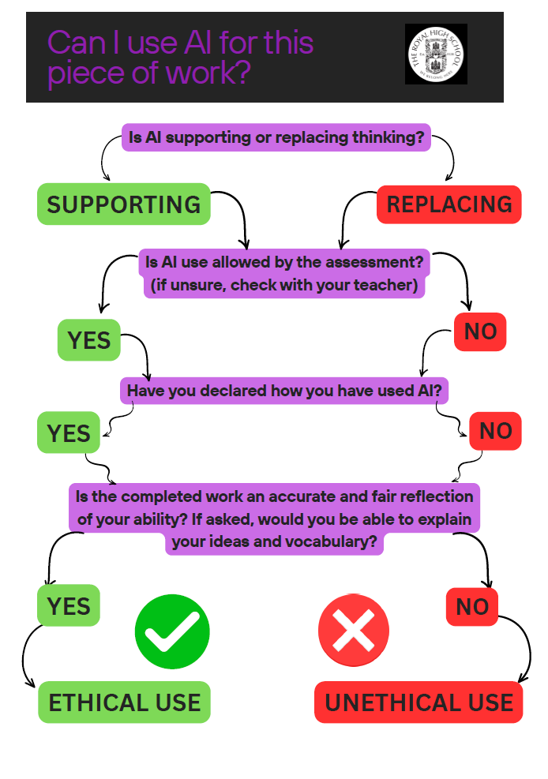

Slide 24
For more information…
BBC Bitesize https://www.bbc.com/bitesize
SQA Past Papers: https://www.sqa.org.uk/pastpapers/findpastpaper.htm
Good article about managing stress and anxiety: https://www.theguardian.com/education/2015/nov/21/how-anxiety-scrambles-your-brain-and-makes-it-hard-to-learn
TED talks- lots of good idea on motivation and revision: https://www.savethestudent.org/extra-guides/inspirational-ted-talks-to-get-you-through-exams.html
Article about blocking apps and improving productivity: https://www.theguardian.com/small-business-network/2014/dec/17/internet-restriction-apps-productivity

